Slide 1


Estimación de Precios Competitivos para Propiedades en AirBnB CDMX Minería y Análisis de Datos
Equipo 5
Raúl Gerardo Reyes Barrón 192129
César Armando Rojas Flores 220019
Rodrigo Alan García Pérez 220211
Emanuel Ortiz Bassoco 130669
León Felipe Gómez Zarza 111203
Ulises Reyes García 152113

Slide 2




Introducción Recordatorio del problema
¿Qué problema existe?
¿Cuál es nuestro objetivo?
Tipo de Análisis
Los dueños de las propiedades listadas en Airbnb no tienen manera de saber cuánto es el precio justo por cobrar por una estancia.
Ayudarle a los dueños de las propiedades a determinar el precio justo que les maximizará sus ingresos.
El tipo de análisis que utilizaremos para el objetivo es predictivo de regresión.

Slide 3



Resumen de la Base de Datos Descripción de la base original
Base de datos
Resumen Estadístico de la base de datos
Archivos en formato .csv
Tabla de:
26,536 x 75
26,536 registros (propiedades)
34 object
23 integer
18 float
75 posibles variables

Slide 4
Resumen de la Base de Datos Descripción de la base original
neighbourhood_group_cleansed | id | listing_url
latitude | scrape_id | last_scraped
longitude | host_id | source
bathrooms | host_listings_count | name
bedrooms | host_total_listings_count | description
beds | accommodates | neighborhood_overview
minimum_nights_avg_ntm | minimum_nights | picture_url
maximum_nights_avg_ntm | maximum_nights | host_url
calendar_updated | minimum_minimum_nights | host_name
review_scores_rating | maximum_minimum_nights | host_since
review_scores_accuracy | minimum_maximum_nights | host_location
review_scores_cleanliness | maximum_maximum_nights | host_about
review_scores_checkin | availability_30 | host_response_time
review_scores_communication | availability_60 | host_response_rate
review_scores_location | availability_90 | host_acceptance_rate
review_scores_value | availability_365 | host_is_superhost
license | price | host_thumbnail_url
reviews_per_month | has_availability | host_picture_url
number_of_reviews_l30d | host_neighbourhood | neighbourhood_cleansed
calculated_host_listings_count | host_verifications | property_type
calculated_host_listings_count_entire_homes | host_has_profile_pic | room_type
calculated_host_listings_count_private_rooms | host_identity_verified | bathrooms_text
calculated_host_listings_count_shared_rooms | neighbourhood | amenities
number_of_reviews | calendar_last_scraped | last_review
number_of_reviews_ltm | first_review | instant_bookable
float64
int64
object

Slide 5
Resumen de la Base de Datos Estadística descriptiva de la base
Métricas | host_listings_count | host_total_listings_count | latitude | longitude | accommodates | bathrooms | bedrooms | beds | minimum_nights | maximum_nights | minimum_minimum_nights | maximum_minimum_nights | minimum_maximum_nights | maximum_maximum_nights | minimum_nights_avg_ntm | maximum_nights_avg_ntm | availability_30 | availability_60 | availability_90
mean | 26.7 | 36.7 | 19.4 | -99.2 | 3.3 | 1.5 | 1.6 | 1.9 | 4.7 | 546.6 | 4.2 | 4.8 | 752.1 | 772.3 | 4.4 | 763.1 | 15.8 | 36.7 | 59.2
std | 83.1 | 150.6 | 0.0 | 0.0 | 2.3 | 1.0 | 1.3 | 1.7 | 24.2 | 431.0 | 23.3 | 25.5 | 461.7 | 468.4 | 23.4 | 468.5 | 11.6 | 22.0 | 31.8
min | 1.0 | 1.0 | 19.2 | -99.3 | 1.0 | 0.0 | 0.0 | 0.0 | 1.0 | 1.0 | 1.0 | 1.0 | 1.0 | 1.0 | 1.0 | 1.0 | 0.0 | 0.0 | 0.0
25% | 1.0 | 2.0 | 19.4 | -99.2 | 2.0 | 1.0 | 1.0 | 1.0 | 1.0 | 190.0 | 1.0 | 1.0 | 365.0 | 365.0 | 1.0 | 365.0 | 2.0 | 20.0 | 39.0
50% | 4.0 | 5.0 | 19.4 | -99.2 | 2.0 | 1.0 | 1.0 | 1.0 | 2.0 | 365.0 | 1.0 | 2.0 | 1,125.0 | 1,125.0 | 2.0 | 1,125.0 | 18.0 | 45.0 | 72.0
75% | 14.0 | 17.0 | 19.4 | -99.2 | 4.0 | 2.0 | 2.0 | 2.0 | 2.0 | 1,125.0 | 2.0 | 3.0 | 1,125.0 | 1,125.0 | 2.4 | 1,125.0 | 27.0 | 57.0 | 87.0
max | 1,776.0 | 9,003.0 | 19.6 | -99.0 | 16.0 | 49.0 | 50.0 | 50.0 | 1,125.0 | 1,825.0 | 1,125.0 | 1,500.0 | 9,999.0 | 9,999.0 | 1,125.0 | 9,999.0 | 30.0 | 60.0 | 90.0
Métricas | availability_365 | number_of_reviews | number_of_reviews_ltm | number_of_reviews_l30d | review_scores_rating | review_scores_accuracy | review_scores_cleanliness | review_scores_checkin | review_scores_communication | review_scores_location | review_scores_value | calculated_host_listings_count | calculated_host_listings_count_entire_homes | calculated_host_listings_count_private_rooms | calculated_host_listings_count_shared_rooms | reviews_per_month
mean | 224.2 | 43.4 | 13.6 | 0.9 | 4.8 | 4.8 | 4.8 | 4.8 | 4.8 | 4.8 | 4.7 | 17.2 | 14.2 | 2.5 | 0.4 | 1.7
std | 124.7 | 73.2 | 19.9 | 1.7 | 0.4 | 0.3 | 0.4 | 0.3 | 0.3 | 0.3 | 0.4 | 43.3 | 42.2 | 6.9 | 3.7 | 1.9
min | 0.0 | 0.0 | 0.0 | 0.0 | 1.0 | 1.0 | 1.0 | 1.0 | 1.0 | 1.0 | 1.0 | 1.0 | 0.0 | 0.0 | 0.0 | 0.0
25% | 116.0 | 3.0 | 0.0 | 0.0 | 4.7 | 4.8 | 4.7 | 4.8 | 4.8 | 4.8 | 4.7 | 1.0 | 0.0 | 0.0 | 0.0 | 0.4
50% | 261.0 | 15.0 | 5.0 | 0.0 | 4.9 | 4.9 | 4.9 | 4.9 | 4.9 | 4.9 | 4.8 | 3.0 | 1.0 | 0.0 | 0.0 | 1.1
75% | 345.0 | 53.0 | 20.0 | 1.0 | 5.0 | 5.0 | 5.0 | 5.0 | 5.0 | 5.0 | 4.9 | 11.0 | 6.0 | 2.0 | 0.0 | 2.4
max | 365.0 | 1,277.0 | 382.0 | 53.0 | 5.0 | 5.0 | 5.0 | 5.0 | 5.0 | 5.0 | 5.0 | 267.0 | 267.0 | 61.0 | 53.0 | 44.4

Slide 6
Resumen de la Base de Datos Descripción de la base original

Slide 7
Datos Faltantes y Limpieza Eliminación de variables originales por motivos diversos
Sin Valor Explicativo
Redundantes
Variables Irrelevantes
'listing_url',
'scrape_id',
'last_scraped',
'source',
'name',
'host_id',
'host_url',
'host_name',
'host_picture_url',
'calendar_updated',
'calendar_last_scraped',
'license'
'host_listings_count',
'neighbourhood'
'number_of_reviews',
'number_of_reviews_ltm',
'number_of_reviews_l30d',
'first_review',
'last_review',
'review_scores_rating',
'review_scores_accuracy',
'review_scores_cleanliness',
'review_scores_checkin',
'review_scores_communication',
'review_scores_location',
'review_scores_value',
'reviews_per_month',
'has_availability',
'availability_30',
'availability_60',
'availability_90',
'availability_365',
'minimum_nights',
'maximum_nights',
'minimum_minimum_nights',
'maximum_minimum_nights',
'minimum_maximum_nights',
'maximum_maximum_nights',
'minimum_nights_avg_ntm',
'maximum_nights_avg_ntm'
Variables con muchos nulos
'neighbourhood_group_cleansed',
'host_neighbourhood'
Variables constantes
'host_has_profile_pic',
'host_identity_verified'

Slide 8
Datos Faltantes y Limpieza Así se ven los números de valores nulos en la base de datos sin las entradas que no tienen precio, que se eliminaron

Slide 9
Datos Faltantes y Limpieza Trasformación de los valores nulos restantes
Variable | Modificación y explicación:
host_acceptance_rate | Rellenado con la media
host_response_rate | Rellenado con la media
bedrooms | Rellenado con una constante (0): casos nulos corresponden a estancias sin habitación, como cuartos compartidos o habitaciones dentro de una casa
beds | Rellenado con una constante (1): se parte del supuesto que todos los AirBnB tienen al menos una cama disponible
host_is_superhost | Rellenado con k-vecinos más cercanos

Slide 10
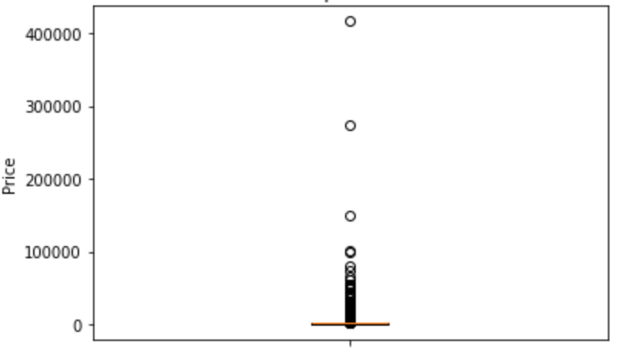
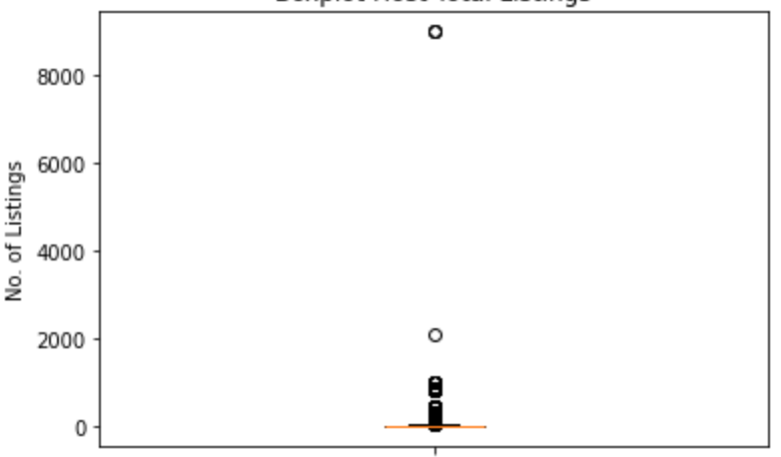
Valores atípicos Distribución de valores atípicos identificados
Price
Host Total Listings Count

Slide 11
Valores Atípicos Tratamiento de valores atípicos
Variable | Modificación y explicación:
price | Selección de datos antes del cuantil 999 (para eliminar precios artificialmente elevados). Aplicación de logaritmo natural.
host_total_listings_count | Aplicación de transformación Box Cox.

Slide 12
Transformaciones e Ingeniería de Variables Se creó una nueva variable y se hicieron transformaciones cúbicas, logarítmicas y cuadráticas
Variables transformada | Creación y explicación:
Distancia de puntos de interés de la CDMX | Cálculo de distancias hacia puntos de interés usando la fórmula de Haversine (distancia en KM para puntos geográficos) sobre longitud y latitud.
Cuadrática, cúbica y logarítmica | Se hicieron intentos por tener mejores modelos, se intentó hacer transformaciones de distintos tipos a todas las variables numéricas.
Comversión de listas a variables numéricas | Transformación de listas (amenidades) a variable numérica que describe el número de elementos en ella.
One-Hot Encoding | Se aplicó un one-hot encoding a todas las variables de carácter nominal.
Tipo de baño | A partir de la variable original "bathrooms_text" se extrajo información sobre el tipo de baño: privado, compartido o sin especificar.

Slide 13
Datos Faltantes y Limpieza Base resultante
dist_to_Zocalo | bedrooms | room_type_Hotel_room
dist_to_Angel_de_la_Independencia | beds | room_type_Shared_room
dist_to_Parque_México | amenities_n | bathrooms_type_unespecified
dist_to_Bosque_de_Chapultepec | calculated_host_listings_count_entire_homes | bathrooms_type_private
dist_to_Coyoacan_Centro | calculated_host_listings_count_private_rooms | bathrooms_type_shared
dist_to_Aeropuerto_Internacional | calculated_host_listings_count_shared_rooms | alcaldia_Cuauhtémoc
dist_to_Monumento_a_la_Revolucion | accommodates | alcaldia_Cuajimalpa_de_Morelos
dist_to_Museo_Soumaya | description | alcaldia_Miguel_Hidalgo
dist_to_Santa_Fe | neighborhood_overview | alcaldia_Coyoacán
dist_to_Estadio_Azteca | host_location | alcaldia_Alvaro_Obregon
dist_to_UNAM | host_about | alcaldia_Benito_Juárez
dist_to_Centro_Comercial_Perisur | host_is_superhost | alcaldia_Iztacalco
dist_to_Palacio_de_Bellas_Artes | instant_bookable | alcaldia_Tlalpan
dist_to_Auditorio_Nacional | host_verifications_email | alcaldia_La_Magdalena_Contreras
dist_to_Basilica_de_Guadalupe | host_verifications_phone | alcaldia_Iztapalapa
host_since_days | host_verifications_work_email | alcaldia_Venustiano_Carranza
host_since_days | host_verifications_no_verifications | alcaldia_Gustavo_A._Madero
host_since_months | host_response_time_within_an_hour | alcaldia_Xochimilco
bathrooms_numeric | host_response_time_a_few_days_or_more | alcaldia_Azcapotzalco
host_total_listings_count | host_response_time_within_a_day | alcaldia_Tláhuac
host_acceptance_rate | host_response_time_within_a_few_hours | alcaldia_Milpa_Alta
host_response_rate | host_response_time_no_response_time | price
latitude | room_type_Entire_home/apt
longitude | room_type_Private_room
69 variables
31 Numéricas
39 Categóricas
Objetivo

Slide 14
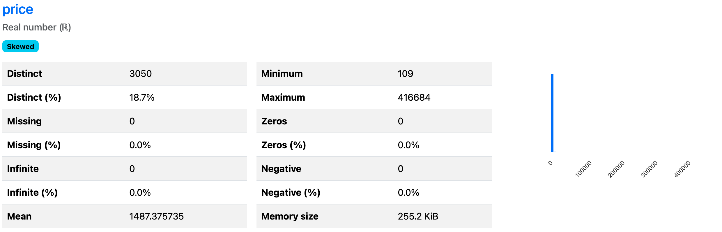
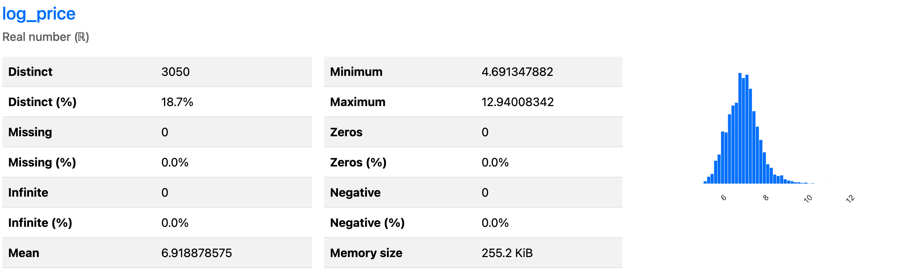
Variable Objetivo La variable objetivo que tenemos es el precio de los hospedajes

Slide 15
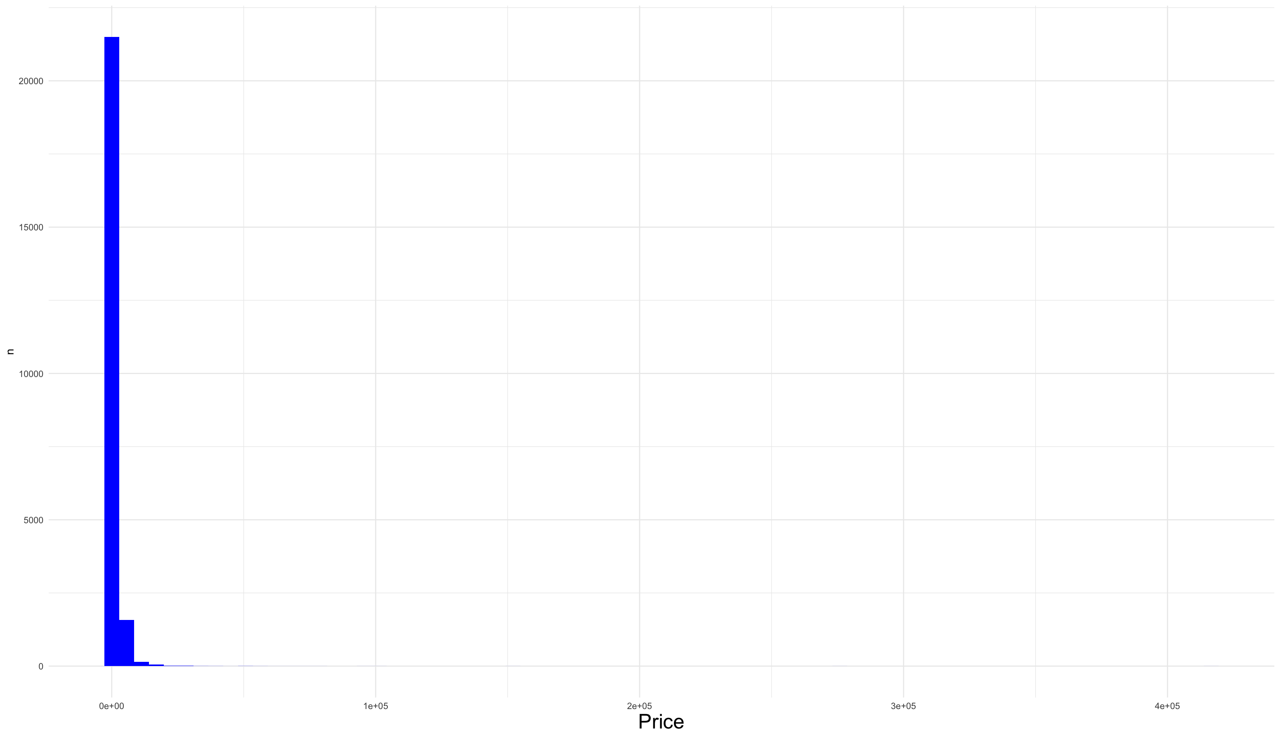
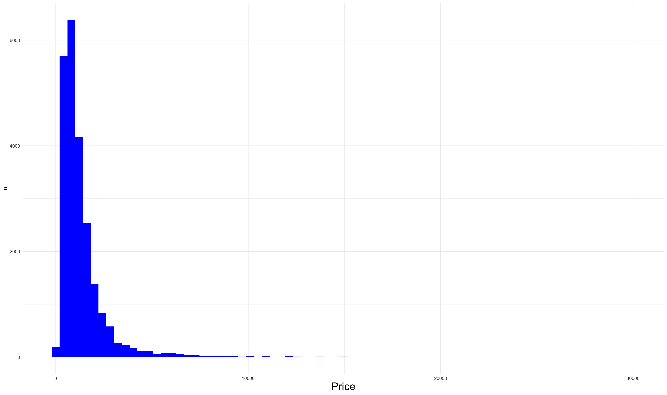
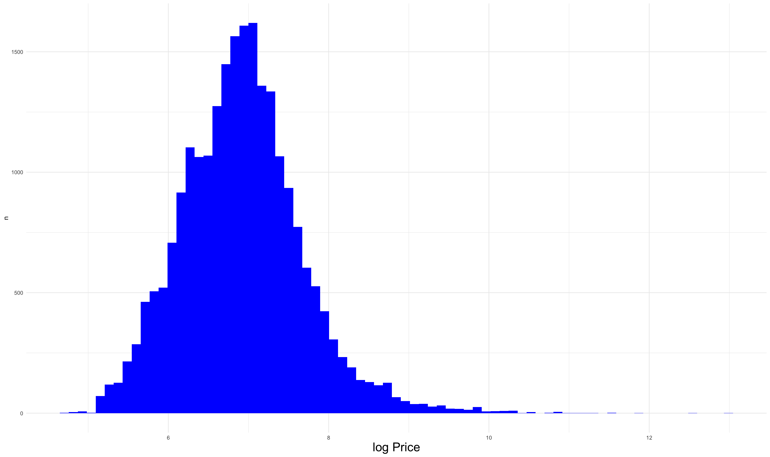
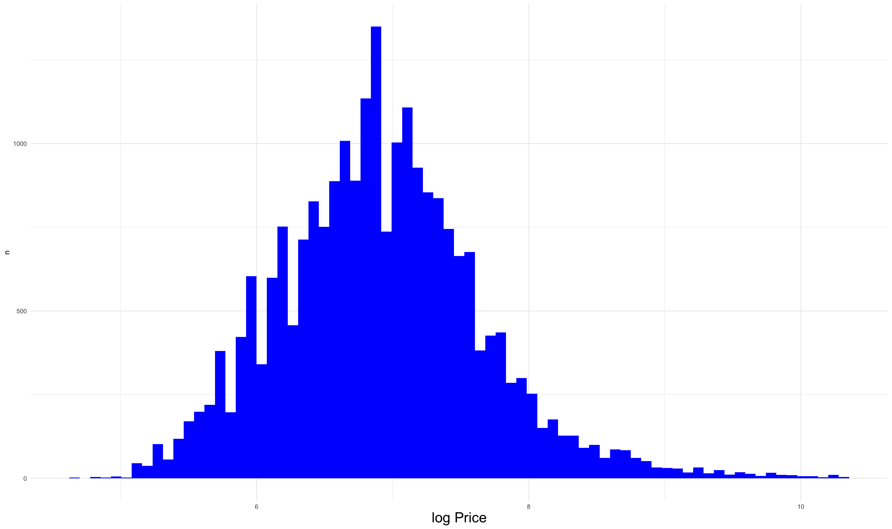
Variable Objetivo La variable objetivo que tenemos es el precio de los hospedajes
Precio original
Precio después de limpieza
Min | 105
Q25 | 600
Mean | 1,476.97
Median | 991
Q75 | 1,552
Max | 416,684
Std Dev | 4,171.87
Nulos | 3,198
Min | 105
Q25 | 600
Mean | 1,394.7
Median | 990
Q75 | 1,550
Max | 30,000
Std Dev | 1,766.7
Min | 4.65
Q25 | 6.39
Mean | 6.91
Median | 6.89
Q75 | 7.35
Max | 12.94
Std Dev | 0.76
Nulos | 3,198
Min | 4.65
Q25 | 6.39
Mean | 6.91
Median | 6.89
Q75 | 7.35
Max | 10.31
Std Dev | 0.75

Slide 16
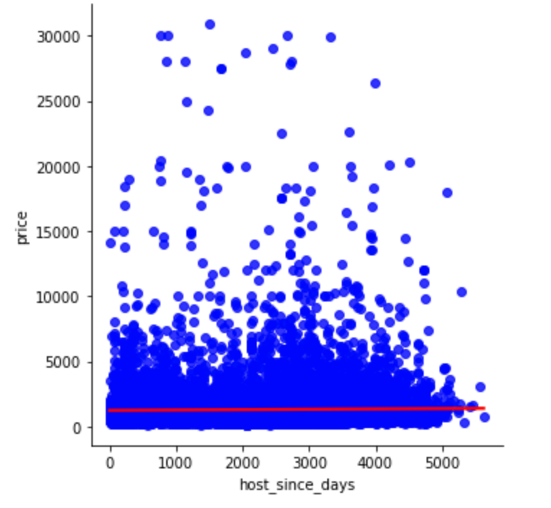
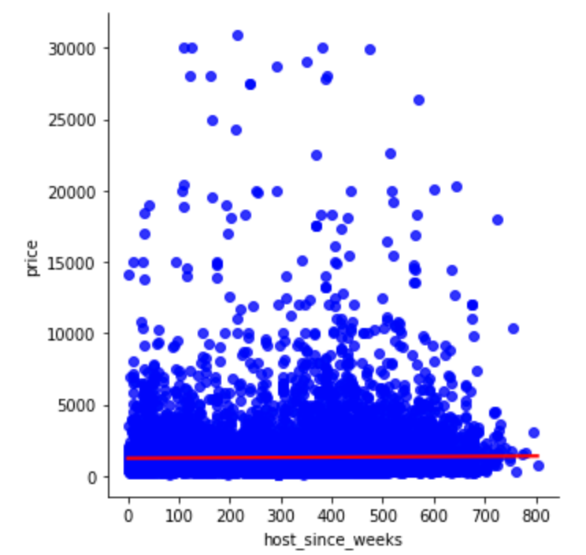
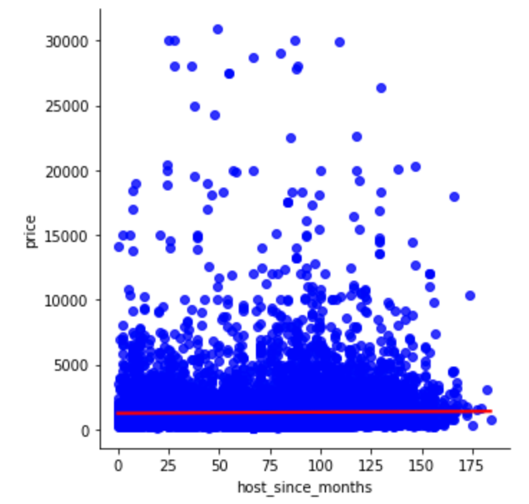
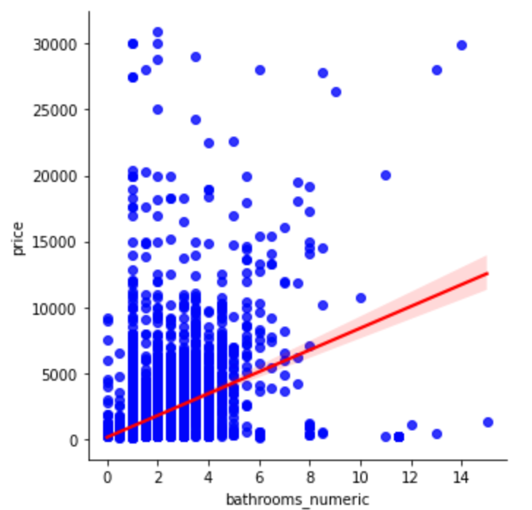
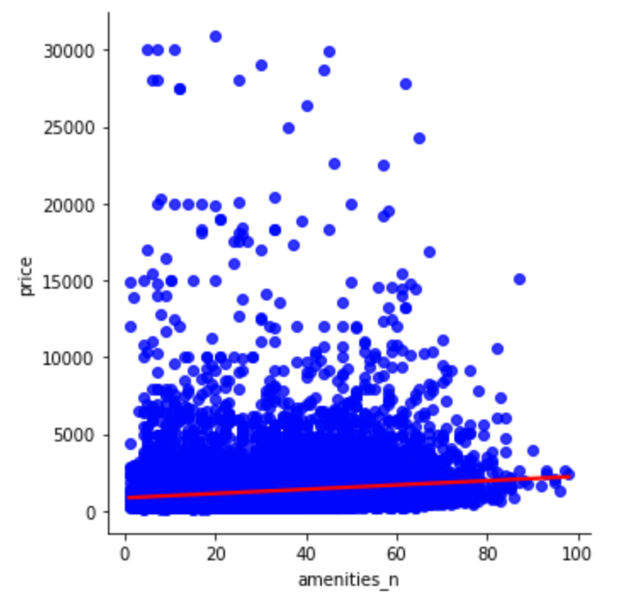
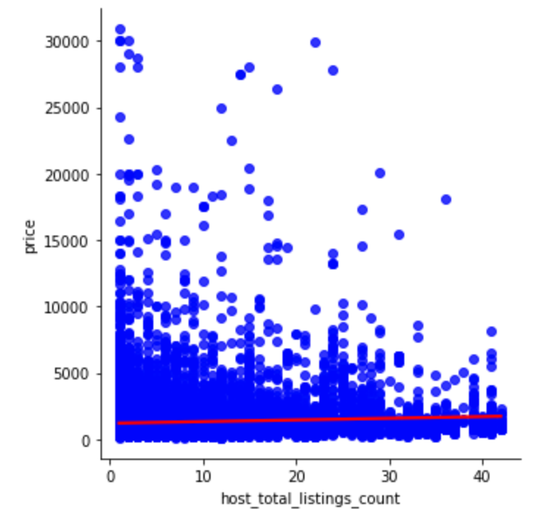
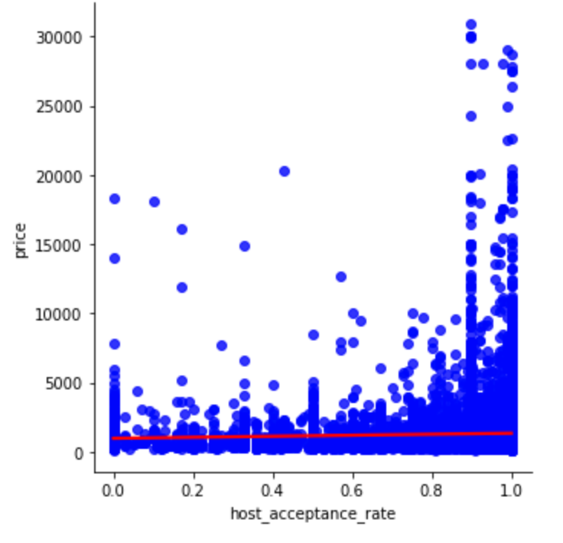
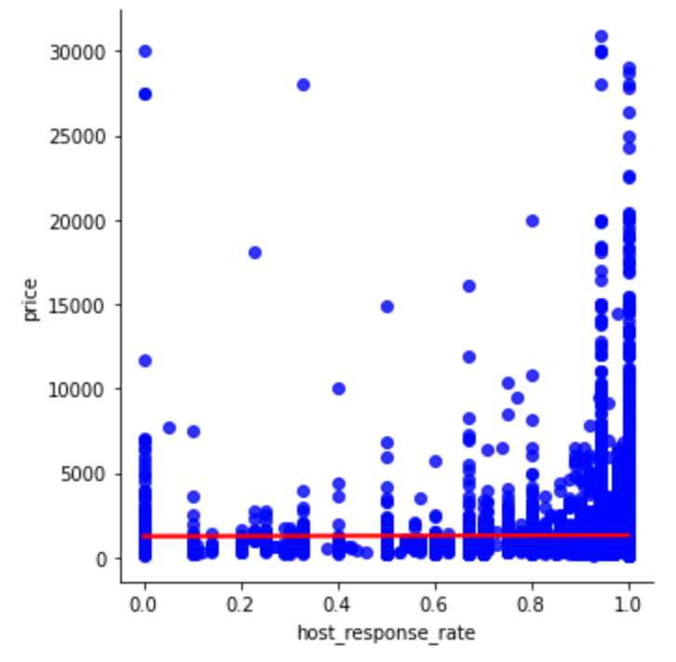
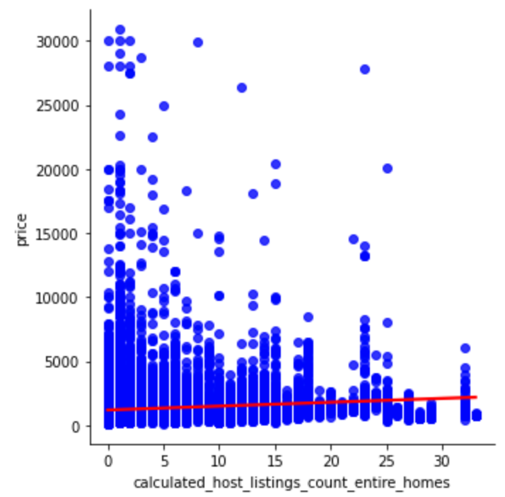
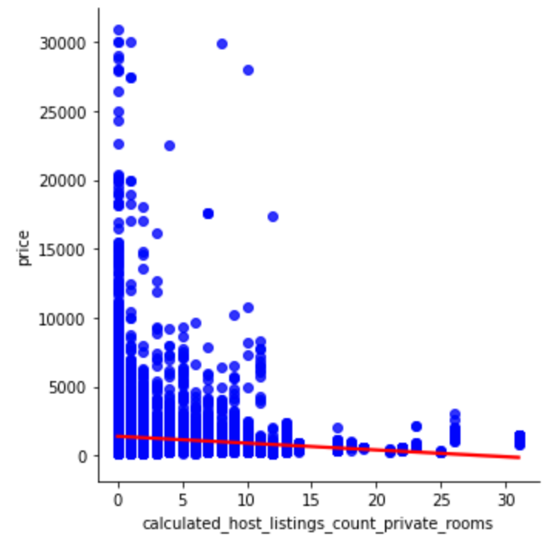
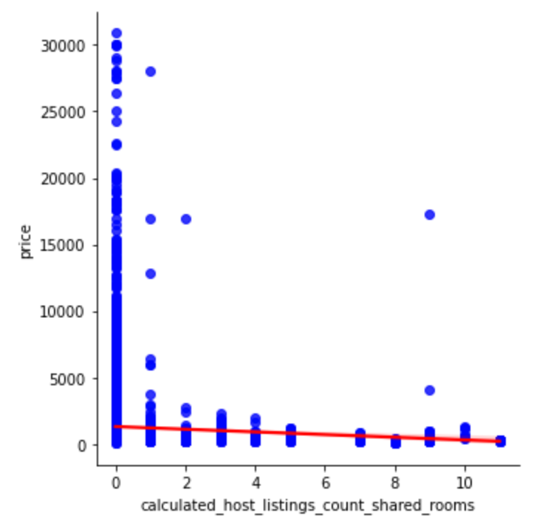
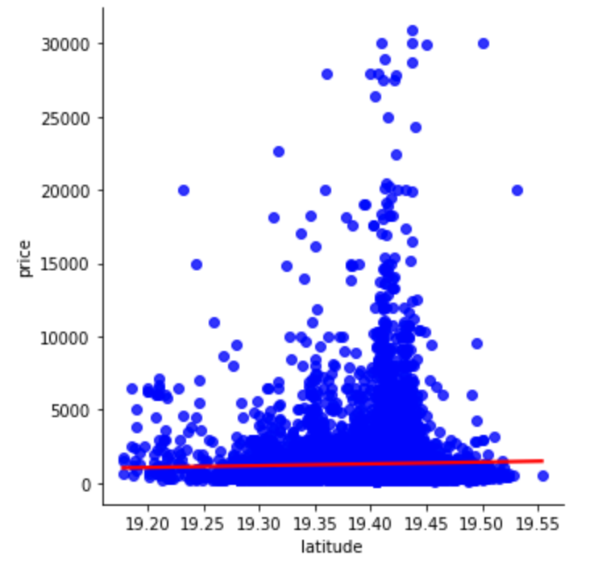
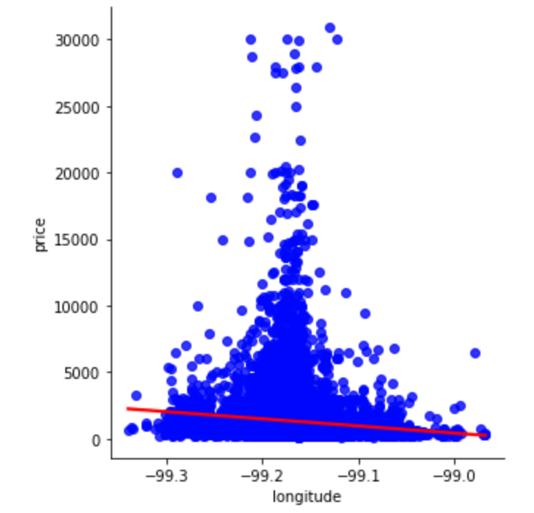
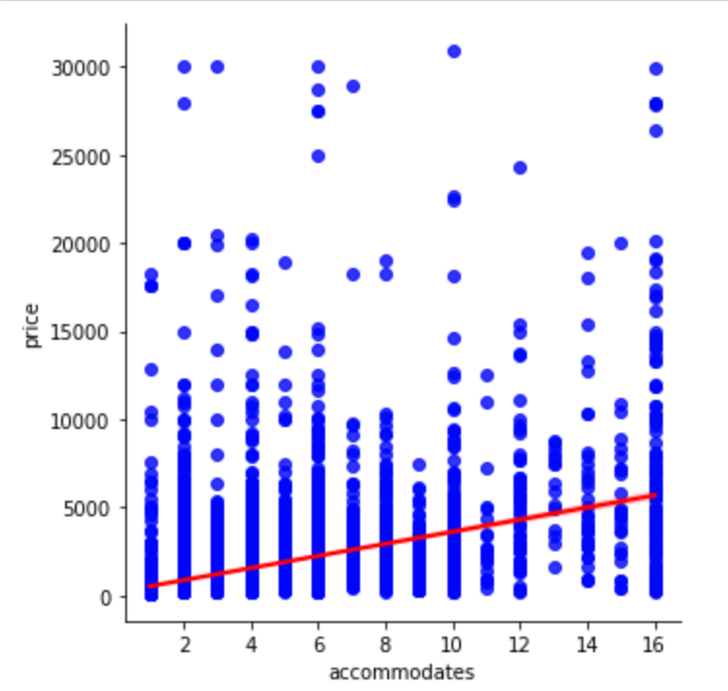
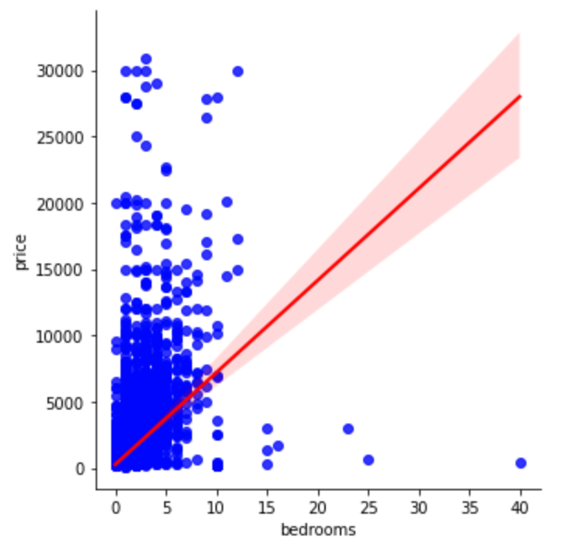
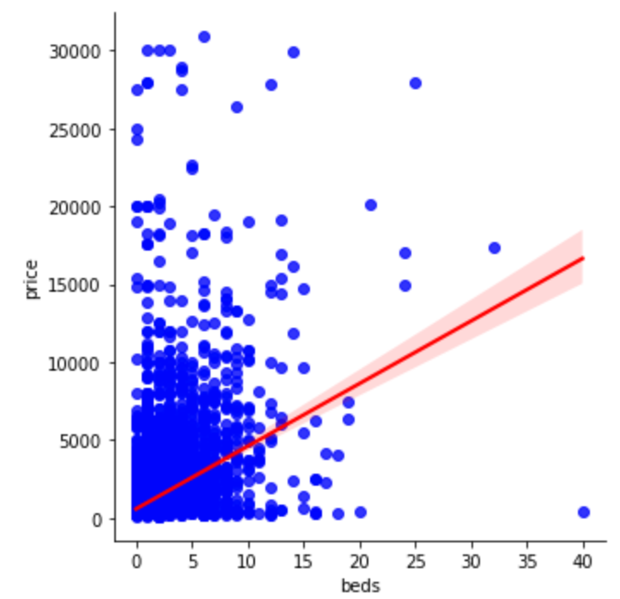
Distribución de Variables Numéricas Gráficas de Dispersión

Slide 17
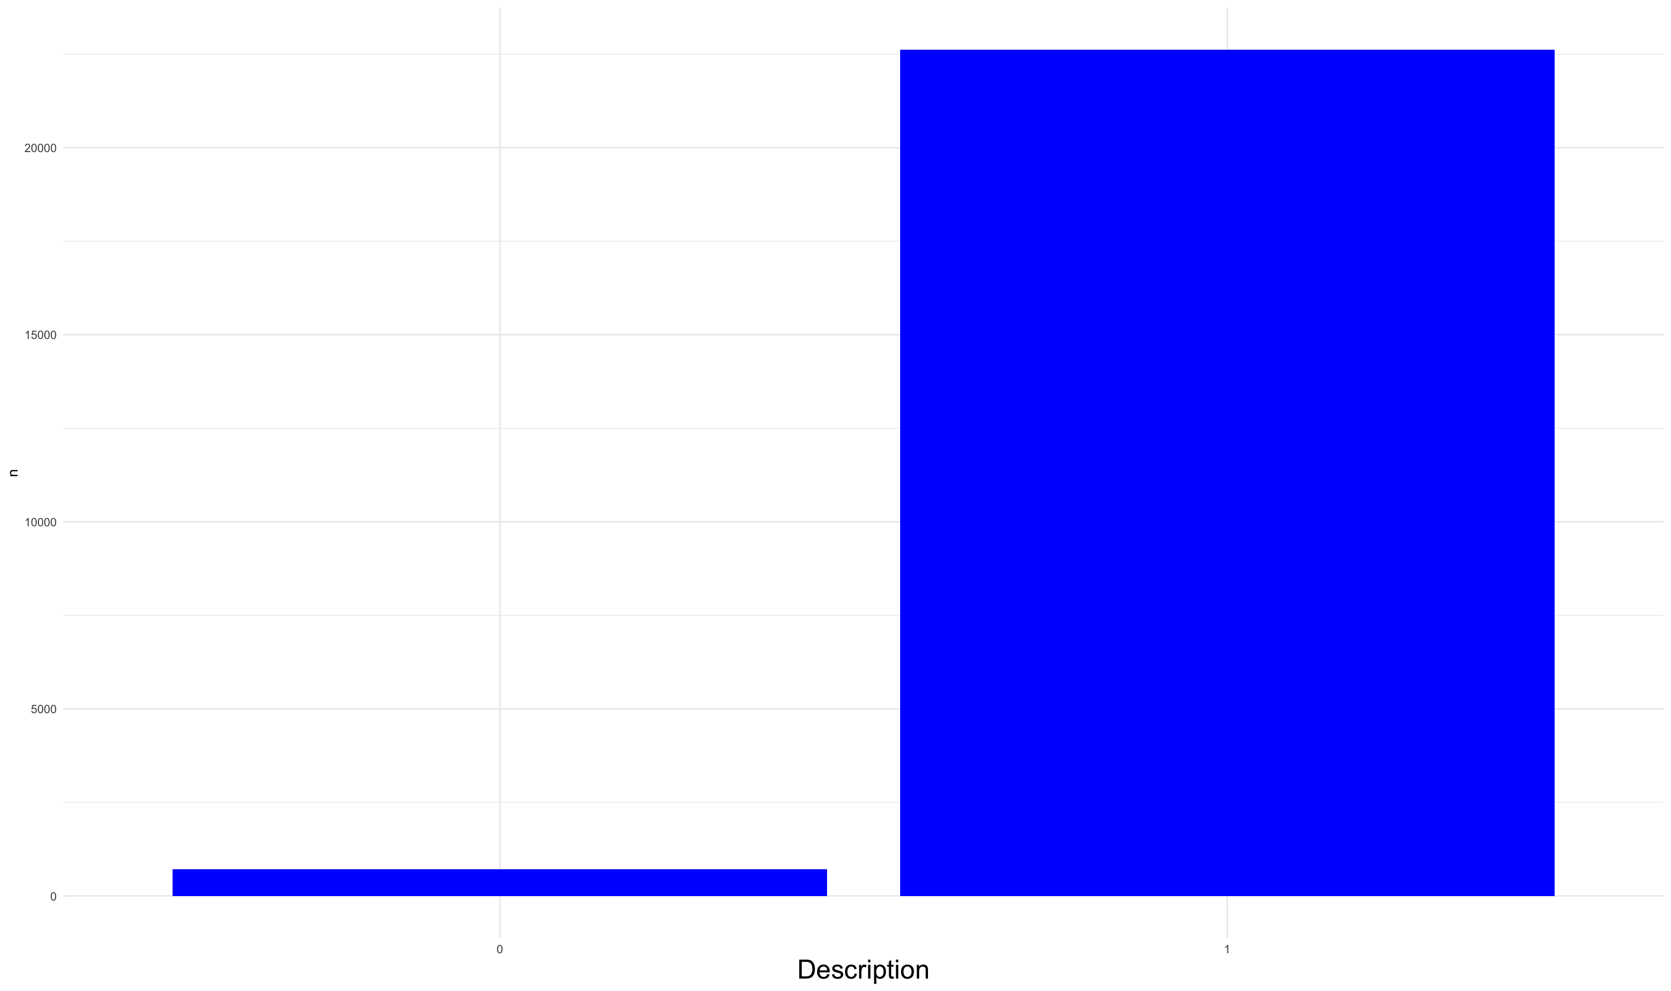
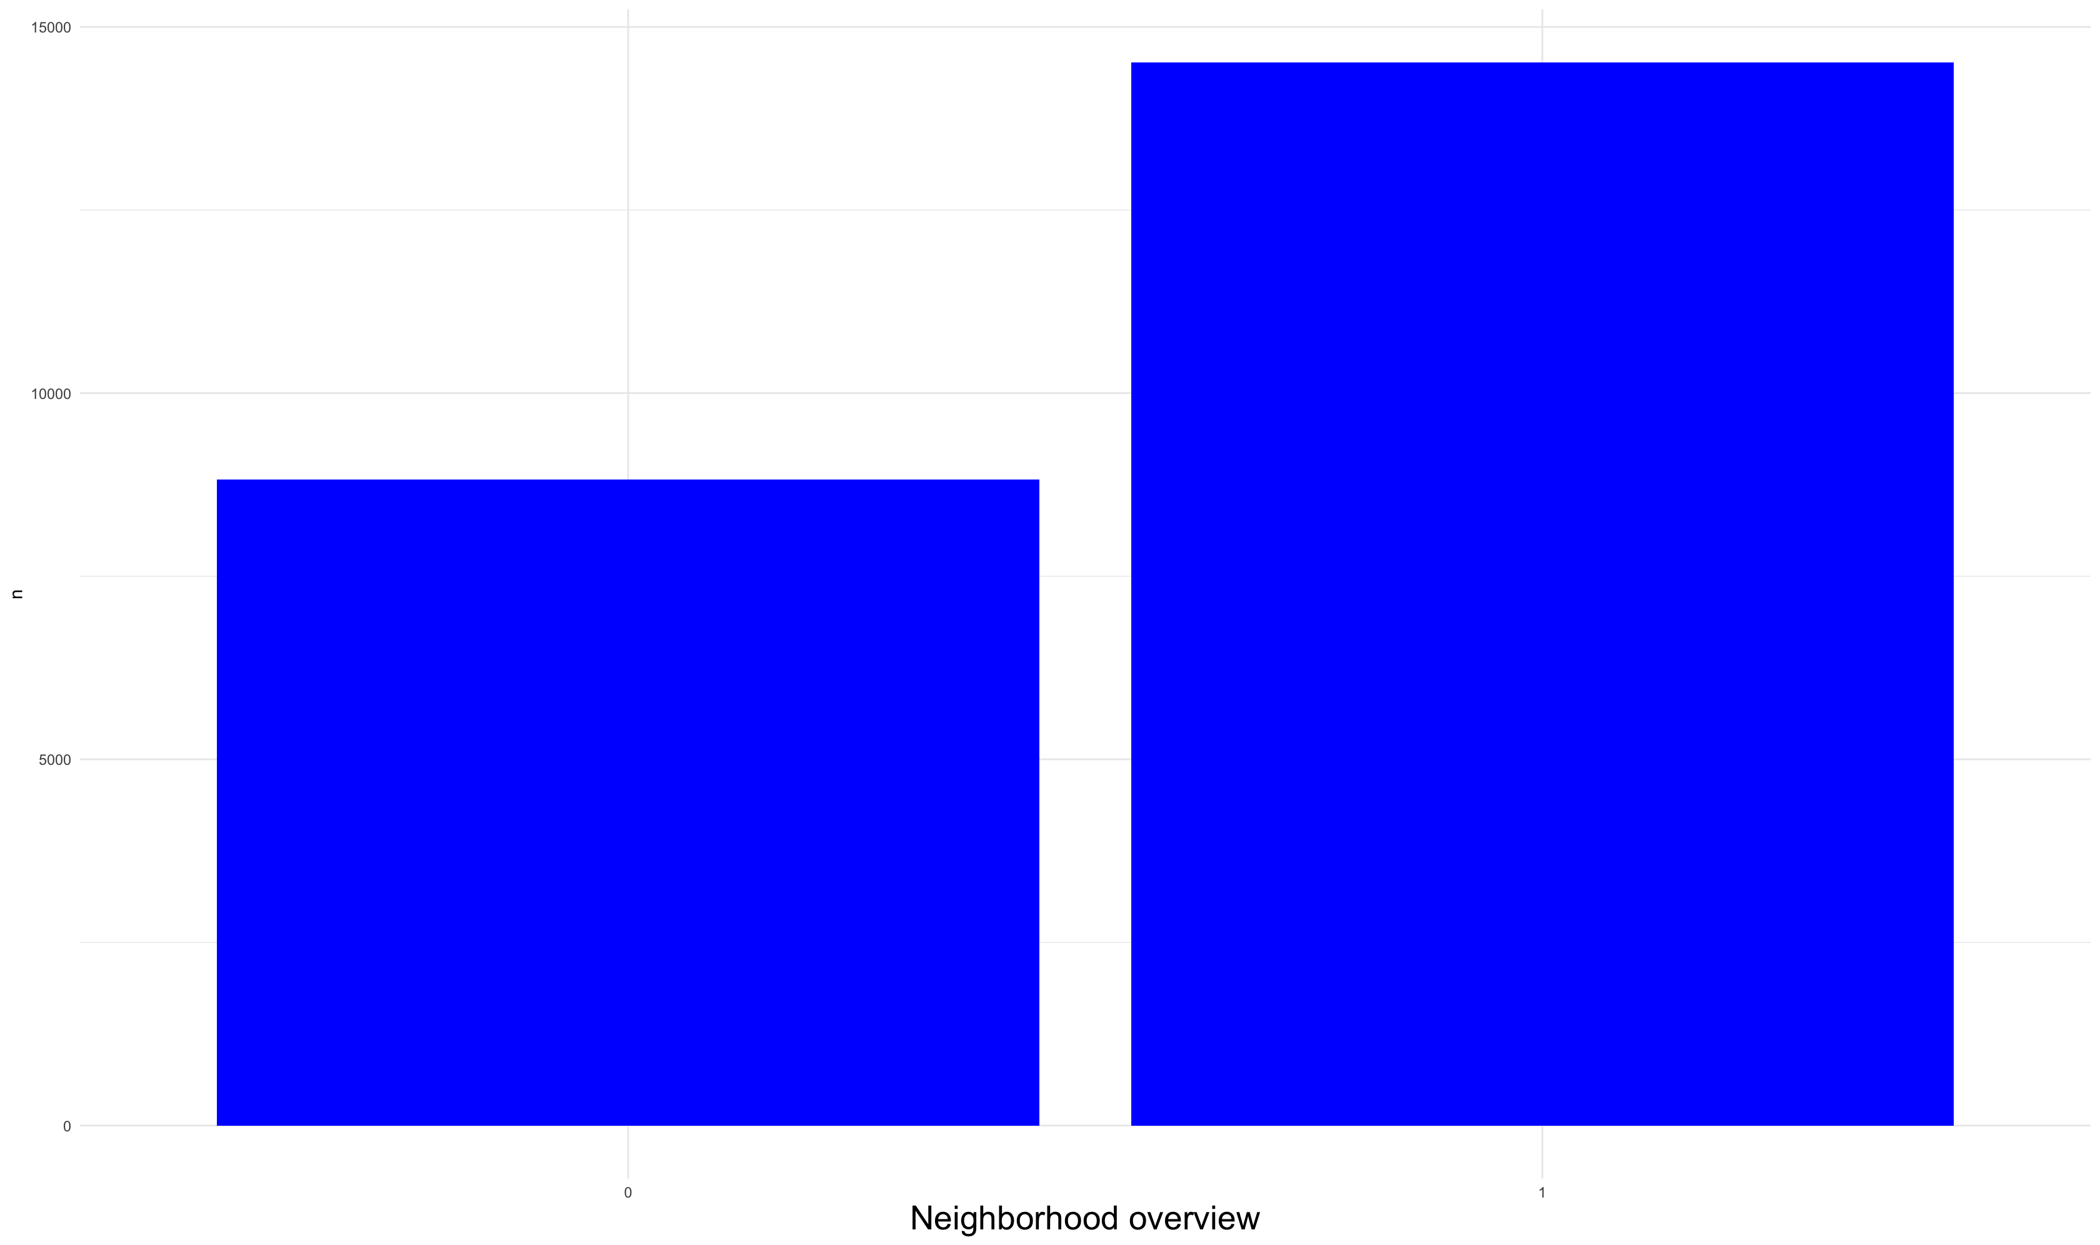
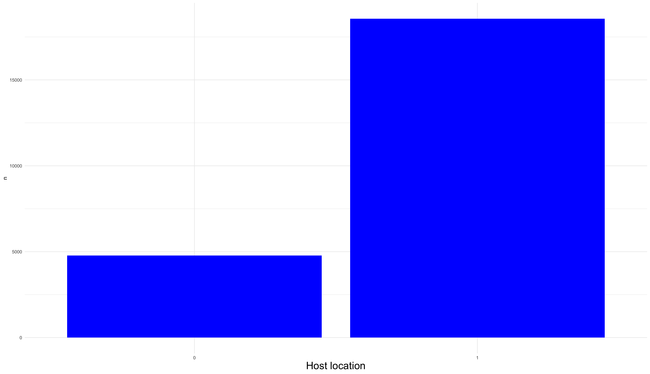
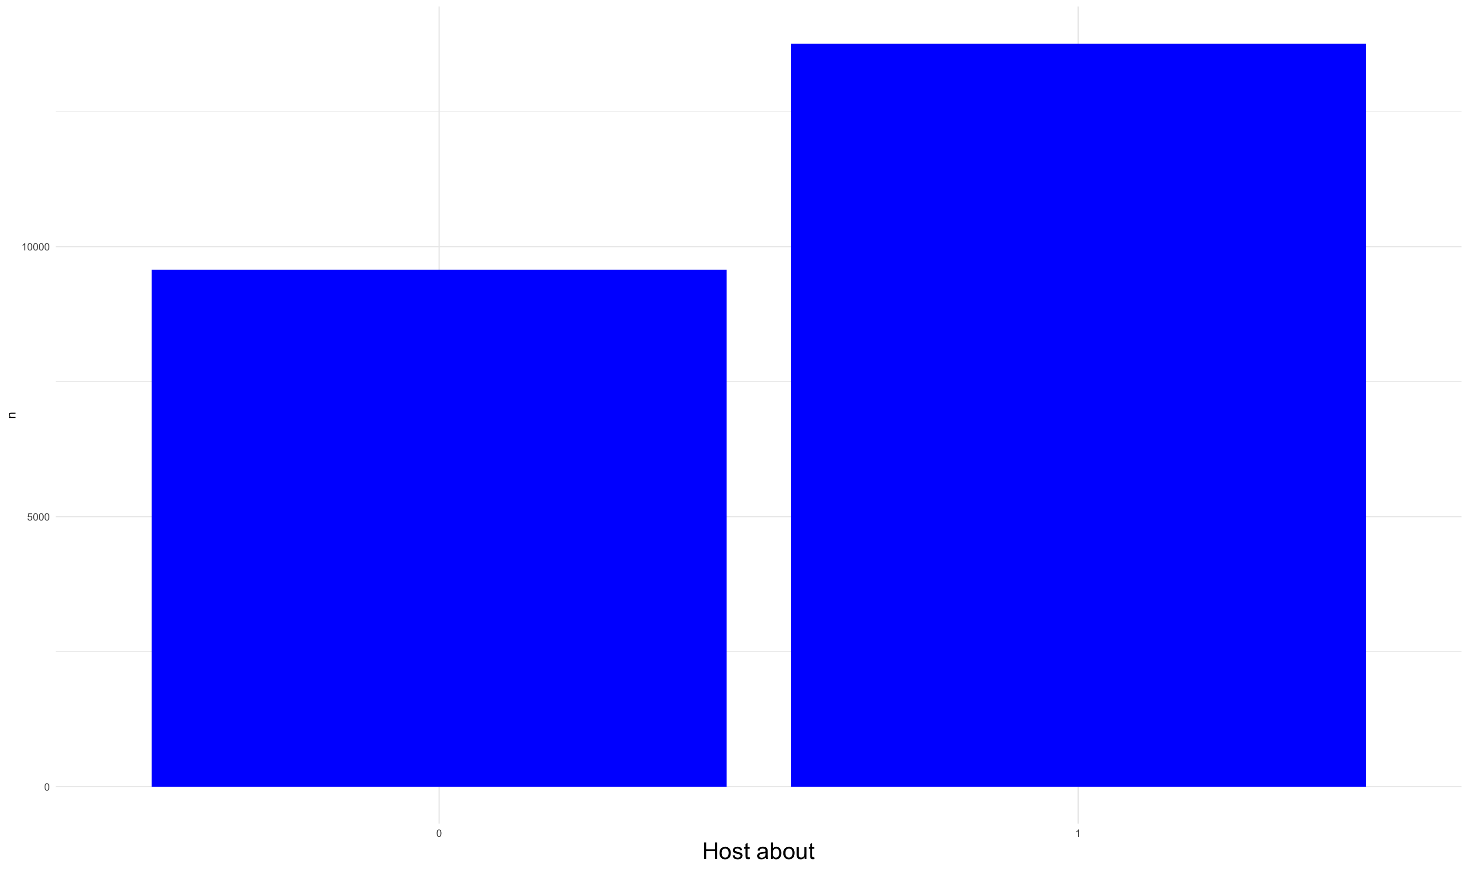
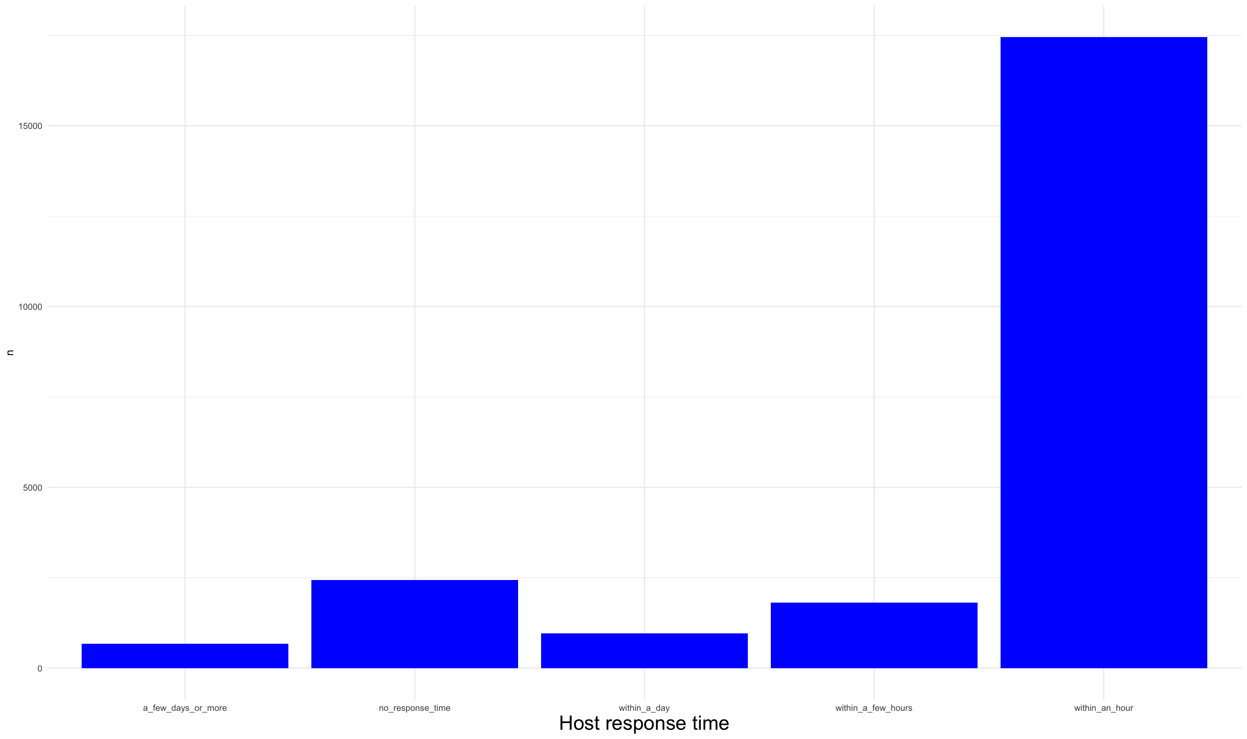
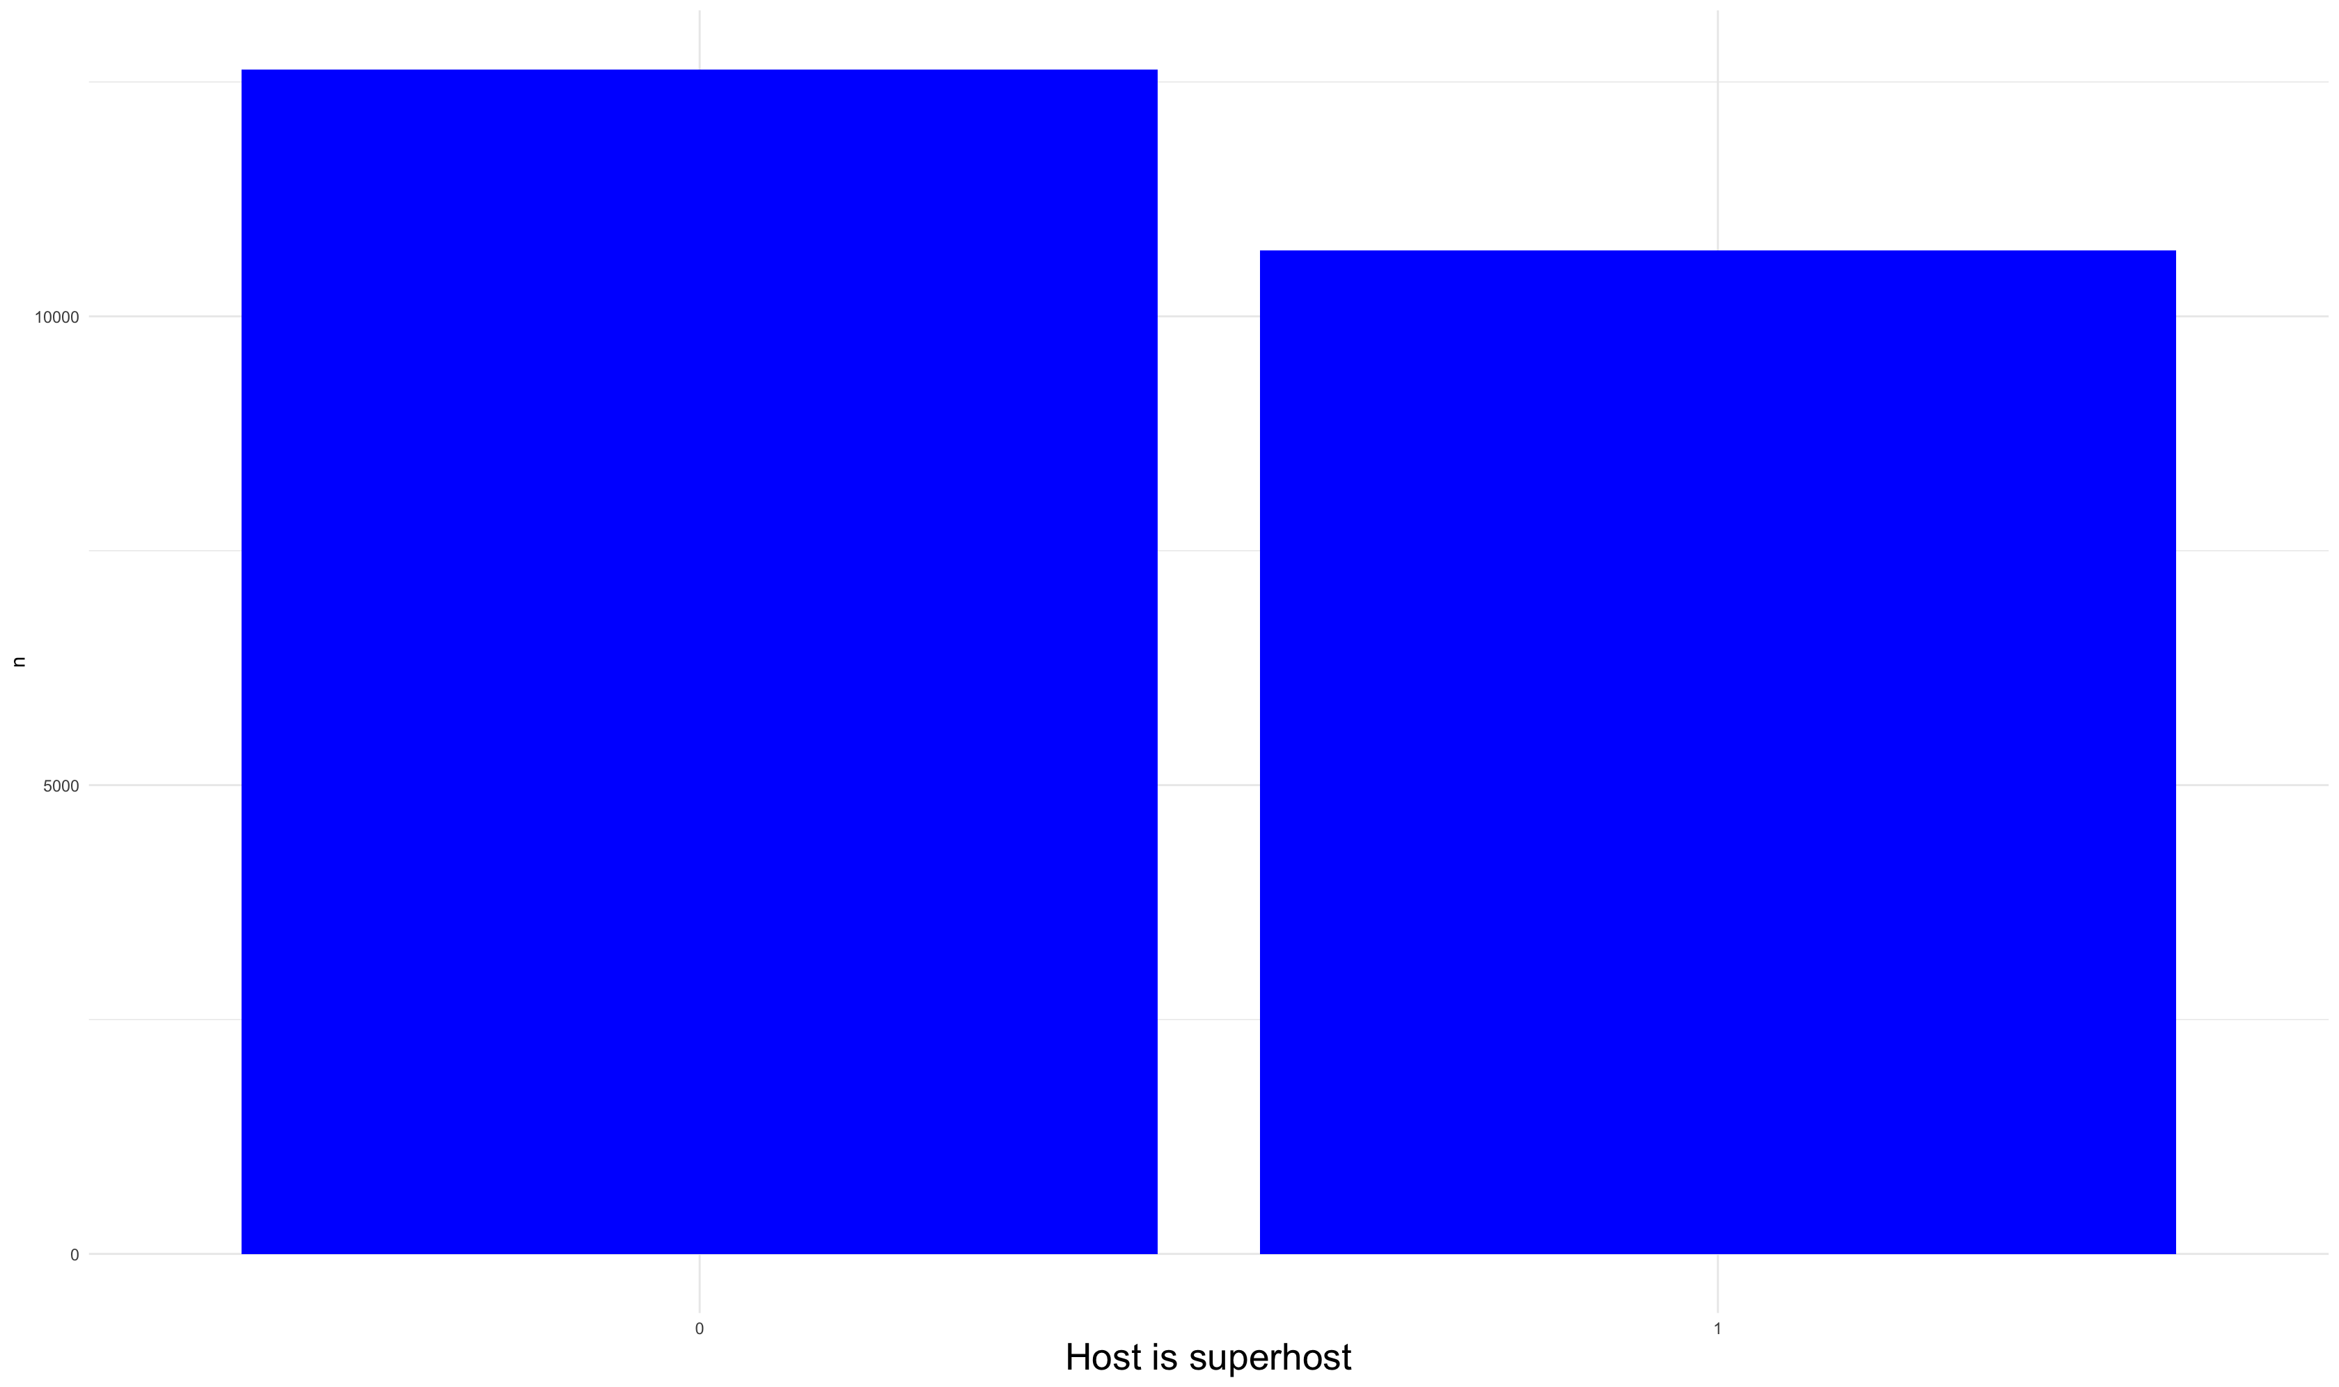
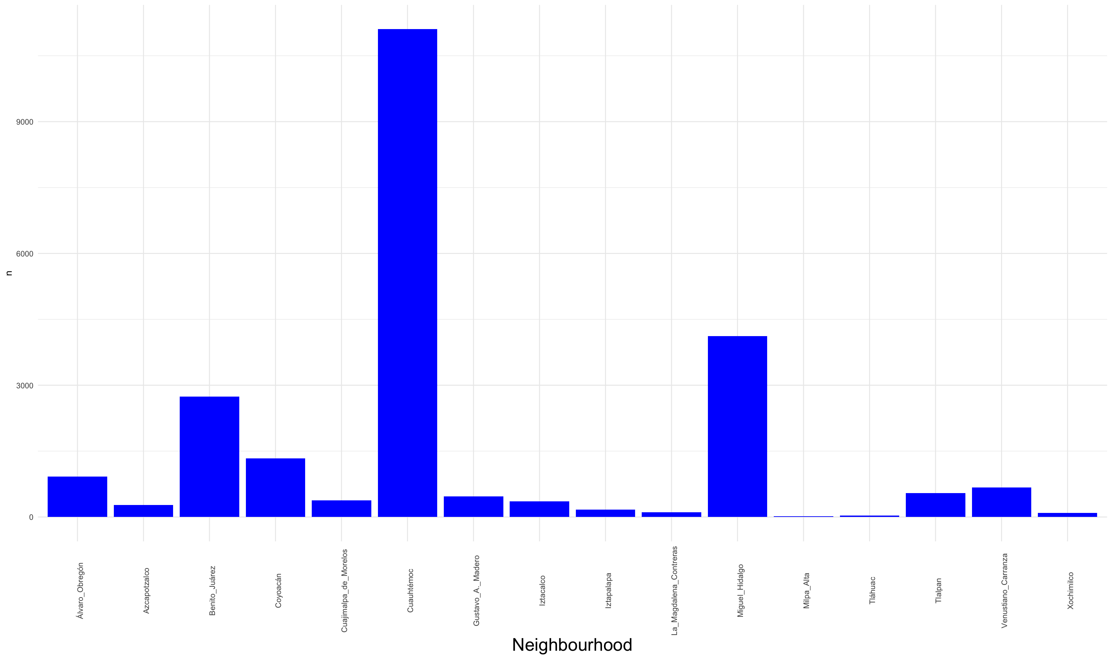
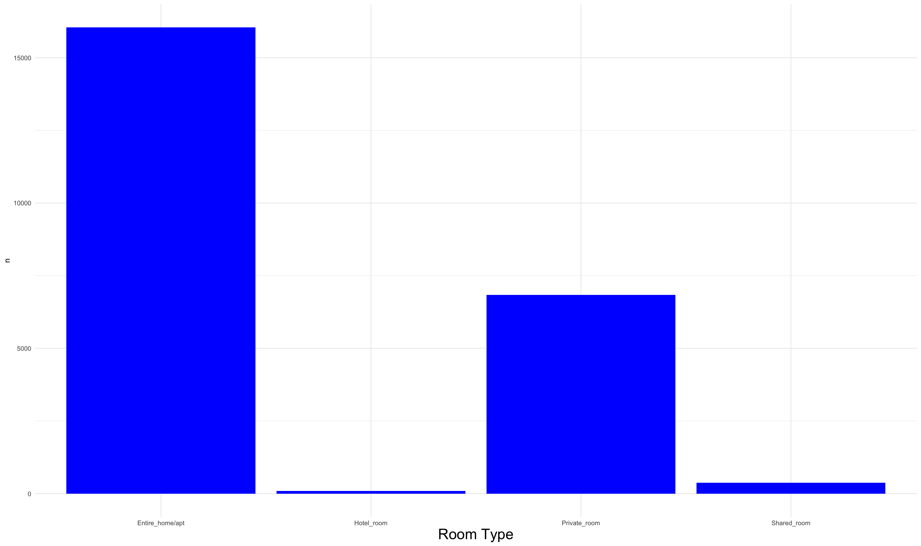
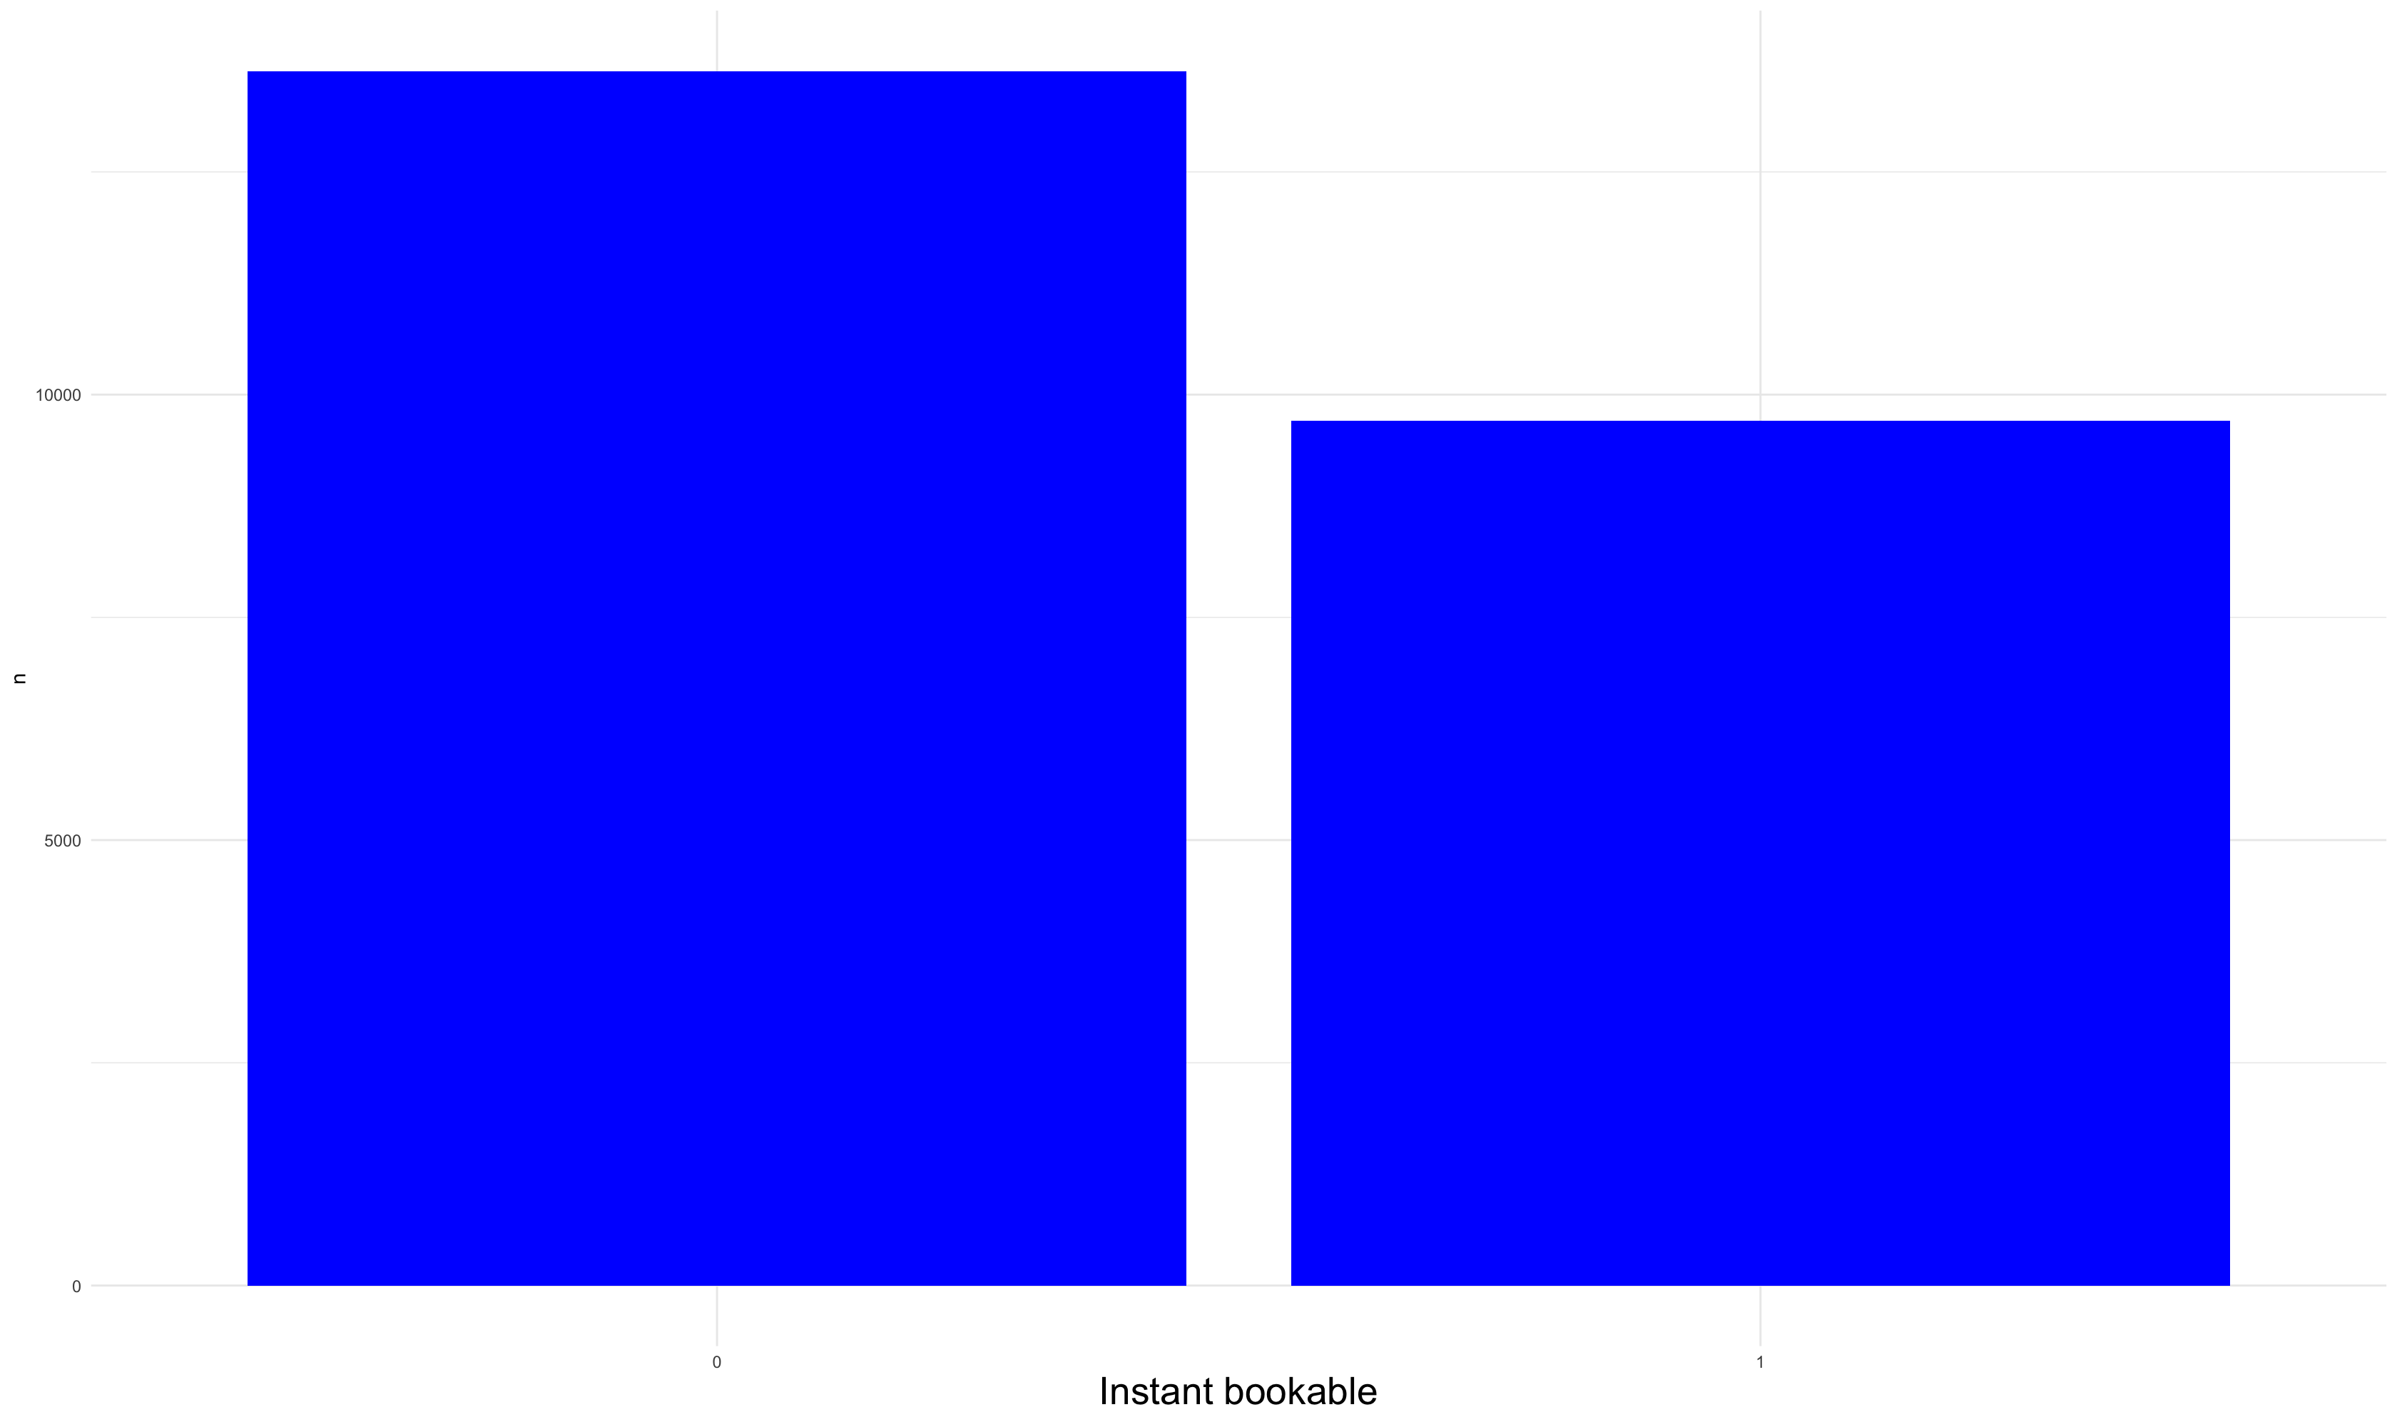
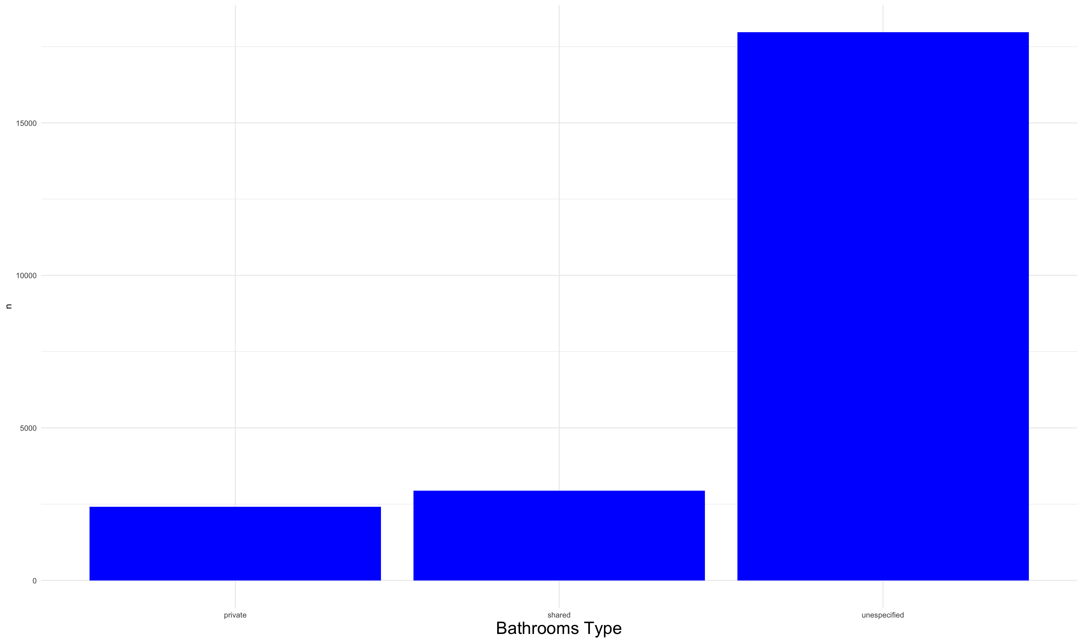
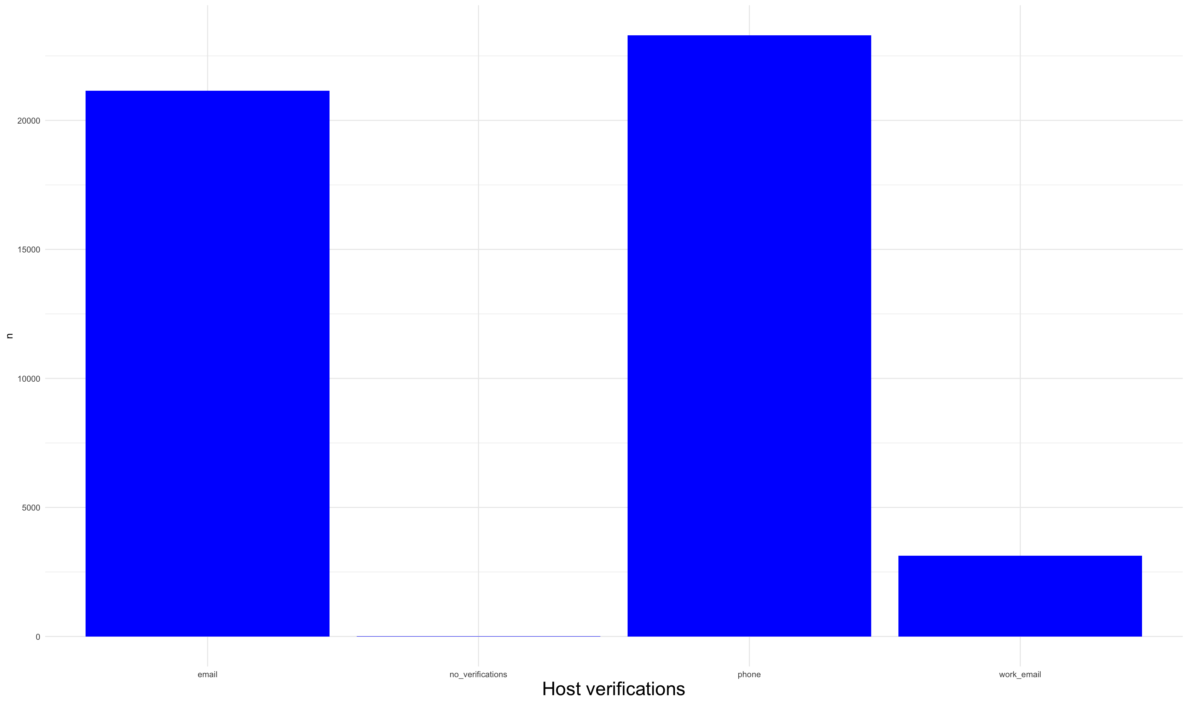
Distribución de Variables Categóricas Gráficas de Barras

Slide 18
Variables Descriptivas La variable descriptiva
EDA Variables Categoricas
EDA Variables Numéricas

Slide 19
Variables Descriptivas Estadística descriptiva de las variables descriptivas numéricas
Métricas | dist_to_Zocalo | dist_to_Angel_de_la_Independencia | dist_to_Parque M√©xico | dist_to_Bosque_de_Chapultepec | dist_to_Coyoacan_Centro | dist_to_Aeropuerto_Internacional | dist_to_Monumento_a_la_Revolucion | dist_to_Museo_Soumaya | dist_to_Santa_Fe | dist_to_Estadio_Azteca | dist_to_UNAM | dist_to_Centro_Comercial_Perisur | dist_to_Palacio_de_Bellas_Artes | dist_to_Auditorio_Nacional | dist_to_Basilica_de_Guadalupe | description | neighborhood_overview | host_location
 | 23,314.0 | 23,314.0 | 23,314.0 | 23,314.0 | 23,314.0 | 23,314.0 | 23,314.0 | 23,314.0 | 23,314.0 | 23,314.0 | 23,314.0 | 23,314.0 | 23,314.0 | 23,314.0 | 23,314.0 | 23,314.0 | 23,314.0 | 23,314.0
mean | 6.0 | 4.4 | 4.2 | 4.7 | 7.5 | 11.2 | 5.1 | 6.7 | 12.1 | 12.5 | 9.7 | 12.5 | 5.6 | 5.2 | 10.9 | 1.0 | 0.6 | 0.8
std | 4.0 | 4.1 | 3.8 | 3.7 | 3.1 | 3.8 | 4.2 | 4.1 | 3.4 | 3.6 | 3.3 | 3.7 | 4.1 | 4.0 | 4.4 | 0.2 | 0.5 | 0.4
min | 0.1 | 0.0 | 0.0 | 0.1 | 0.0 | 0.6 | 0.0 | 0.0 | 0.2 | 0.3 | 0.5 | 0.2 | 0.0 | 0.0 | 0.2 | 0.0 | 0.0 | 0.0
25% | 3.6 | 1.7 | 1.5 | 2.2 | 5.8 | 9.4 | 2.4 | 4.4 | 10.6 | 11.2 | 8.2 | 11.1 | 3.1 | 2.5 | 8.5 | 1.0 | 0.0 | 1.0
50% | 5.0 | 2.8 | 3.2 | 3.3 | 7.4 | 10.8 | 3.8 | 5.5 | 11.7 | 13.0 | 9.9 | 12.9 | 4.5 | 3.7 | 10.1 | 1.0 | 1.0 | 1.0
75% | 7.2 | 5.9 | 5.5 | 6.0 | 9.3 | 12.6 | 6.3 | 8.3 | 13.3 | 14.8 | 11.7 | 14.8 | 6.7 | 6.5 | 11.8 | 1.0 | 1.0 | 1.0
max | 31.8 | 33.0 | 32.0 | 32.9 | 26.3 | 32.4 | 33.1 | 36.5 | 34.4 | 27.9 | 26.5 | 28.0 | 32.4 | 34.3 | 36.2 | 1.0 | 1.0 | 1.0
Métricas | host_about | host_is_superhost | host_has_profile_pic | host_identity_verified | instant_bookable | host_verifications_email | host_verifications_phone | host_verifications_work_email | host_verifications_no_verifications | host_response_time_within_an_hour | host_response_time_a_few_days_or_more | host_response_time_within_a_day | host_response_time_within_a_few_hours | host_response_time_no_response_time | room_type_Entire_home/apt | room_type_Private_room | room_type_Hotel_room | room_type_Shared_room
 | 23,314.0 | 23,314.0 | 23,314.0 | 23,314.0 | 23,314.0 | 23,314.0 | 23,314.0 | 23,314.0 | 23,314.0 | 23,314.0 | 23,314.0 | 23,314.0 | 23,314.0 | 23,314.0 | 23,314.0 | 23,314.0 | 23,314.0 | 23,314.0
mean | 0.6 | 0.5 | 1.0 | 1.0 | 0.4 | 0.9 | 1.0 | 0.1 | 0.0 | 0.7 | 0.0 | 0.0 | 0.1 | 0.1 | 0.7 | 0.3 | 0.0 | 0.0
std | 0.5 | 0.5 | 0.0 | 0.0 | 0.5 | 0.3 | 0.0 | 0.3 | 0.0 | 0.4 | 0.2 | 0.2 | 0.3 | 0.3 | 0.5 | 0.5 | 0.1 | 0.1
min | 0.0 | 0.0 | 1.0 | 1.0 | 0.0 | 0.0 | 0.0 | 0.0 | 0.0 | 0.0 | 0.0 | 0.0 | 0.0 | 0.0 | 0.0 | 0.0 | 0.0 | 0.0
25% | 0.0 | 0.0 | 1.0 | 1.0 | 0.0 | 1.0 | 1.0 | 0.0 | 0.0 | 0.0 | 0.0 | 0.0 | 0.0 | 0.0 | 0.0 | 0.0 | 0.0 | 0.0
50% | 1.0 | 0.0 | 1.0 | 1.0 | 0.0 | 1.0 | 1.0 | 0.0 | 0.0 | 1.0 | 0.0 | 0.0 | 0.0 | 0.0 | 1.0 | 0.0 | 0.0 | 0.0
75% | 1.0 | 1.0 | 1.0 | 1.0 | 1.0 | 1.0 | 1.0 | 0.0 | 0.0 | 1.0 | 0.0 | 0.0 | 0.0 | 0.0 | 1.0 | 1.0 | 0.0 | 0.0
max | 1.0 | 1.0 | 1.0 | 1.0 | 1.0 | 1.0 | 1.0 | 1.0 | 1.0 | 1.0 | 1.0 | 1.0 | 1.0 | 1.0 | 1.0 | 1.0 | 1.0 | 1.0

Slide 20
Variables Descriptivas Estadística descriptiva de las variables descriptivas numéricas
Métricas | bathrooms_type_unespecified | bathrooms_type_private | bathrooms_type_shared | alcaldia_Cuauht√©moc | alcaldia_Cuajimalpa_de_Morelos | alcaldia_Miguel_Hidalgo | alcaldia_Coyoac√°n | alcaldia_√Ålvaro_Obreg√≥n | alcaldia_Benito_Ju√°rez | alcaldia_Iztacalco | alcaldia_Tlalpan | alcaldia_La_Magdalena_Contreras | alcaldia_Iztapalapa | alcaldia_Venustiano_Carranza | alcaldia_Gustavo_A._Madero | alcaldia_Xochimilco | alcaldia_Azcapotzalco | alcaldia_Tl√°huac
 | 23,314.0 | 23,314.0 | 23,314.0 | 23,314.0 | 23,314.0 | 23,314.0 | 23,314.0 | 23,314.0 | 23,314.0 | 23,314.0 | 23,314.0 | 23,314.0 | 23,314.0 | 23,314.0 | 23,314.0 | 23,314.0 | 23,314.0 | 23,314.0
mean | 0.8 | 0.1 | 0.1 | 0.5 | 0.0 | 0.2 | 0.1 | 0.0 | 0.1 | 0.0 | 0.0 | 0.0 | 0.0 | 0.0 | 0.0 | 0.0 | 0.0 | 0.0
std | 0.4 | 0.3 | 0.3 | 0.5 | 0.1 | 0.4 | 0.2 | 0.2 | 0.3 | 0.1 | 0.2 | 0.1 | 0.1 | 0.2 | 0.1 | 0.1 | 0.1 | 0.0
min | 0.0 | 0.0 | 0.0 | 0.0 | 0.0 | 0.0 | 0.0 | 0.0 | 0.0 | 0.0 | 0.0 | 0.0 | 0.0 | 0.0 | 0.0 | 0.0 | 0.0 | 0.0
25% | 1.0 | 0.0 | 0.0 | 0.0 | 0.0 | 0.0 | 0.0 | 0.0 | 0.0 | 0.0 | 0.0 | 0.0 | 0.0 | 0.0 | 0.0 | 0.0 | 0.0 | 0.0
50% | 1.0 | 0.0 | 0.0 | 0.0 | 0.0 | 0.0 | 0.0 | 0.0 | 0.0 | 0.0 | 0.0 | 0.0 | 0.0 | 0.0 | 0.0 | 0.0 | 0.0 | 0.0
75% | 1.0 | 0.0 | 0.0 | 1.0 | 0.0 | 0.0 | 0.0 | 0.0 | 0.0 | 0.0 | 0.0 | 0.0 | 0.0 | 0.0 | 0.0 | 0.0 | 0.0 | 0.0
max | 1.0 | 1.0 | 1.0 | 1.0 | 1.0 | 1.0 | 1.0 | 1.0 | 1.0 | 1.0 | 1.0 | 1.0 | 1.0 | 1.0 | 1.0 | 1.0 | 1.0 | 1.0
Métricas | alcaldia_Milpa_Alta | host_since_days | host_since_weeks | host_since_months | bathrooms_numeric | amenities_n | host_total_listings_count | host_acceptance_rate | host_response_rate | calculated_host_listings_count_entire_homes | calculated_host_listings_count_private_rooms | calculated_host_listings_count_shared_rooms | latitude | longitude | accommodates | bedrooms | beds | price
 | 23,314.0 | 23,314.0 | 23,314.0 | 23,314.0 | 23,314.0 | 23,314.0 | 23,314.0 | 23,314.0 | 23,314.0 | 23,314.0 | 23,314.0 | 23,314.0 | 23,314.0 | 23,314.0 | 23,314.0 | 23,314.0 | 23,314.0 | 23,314.0
mean | 0.0 | 2,258.5 | 322.6 | 73.7 | 1.5 | 33.4 | 1.4 | 0.9 | 0.9 | 15.5 | 2.6 | 0.4 | 19.4 | -99.2 | 3.4 | 1.6 | 1.9 | 1,394.7
std | 0.0 | 1,177.6 | 168.2 | 38.7 | 1.0 | 16.1 | 1.0 | 0.2 | 0.2 | 44.0 | 7.1 | 3.9 | 0.0 | 0.0 | 2.4 | 1.2 | 1.7 | 1,766.7
min | 0.0 | 2.0 | 0.3 | 0.0 | 0.0 | 1.0 | 0.0 | 0.0 | 0.0 | 0.0 | 0.0 | 0.0 | 19.2 | -99.3 | 1.0 | 0.0 | 0.0 | 105.0
25% | 0.0 | 1,311.0 | 187.3 | 43.0 | 1.0 | 22.0 | 0.6 | 0.9 | 1.0 | 1.0 | 0.0 | 0.0 | 19.4 | -99.2 | 2.0 | 1.0 | 1.0 | 600.0
50% | 0.0 | 2,440.0 | 348.6 | 80.0 | 1.0 | 33.0 | 1.5 | 1.0 | 1.0 | 2.0 | 0.0 | 0.0 | 19.4 | -99.2 | 3.0 | 1.0 | 1.0 | 990.0
75% | 0.0 | 3,119.0 | 445.6 | 102.0 | 2.0 | 44.0 | 2.1 | 1.0 | 1.0 | 7.0 | 2.0 | 0.0 | 19.4 | -99.2 | 4.0 | 2.0 | 2.0 | 1,550.0
max | 1.0 | 5,623.0 | 803.3 | 184.0 | 49.0 | 98.0 | 3.9 | 1.0 | 1.0 | 267.0 | 61.0 | 53.0 | 19.6 | -99.0 | 16.0 | 50.0 | 50.0 | 30,000.0

Slide 21
Variables Descriptivas Anova variables categóricas
 | DF | Sum Sq | Mean Sq | F value | Pr(>F) | Significance
description | 1 | 9,660,000 | 9,660,000 | 0.6 | 0.4515 | 1.0
neighborhood_overview | 1 | 219,000,000 | 219,000,000 | 12.8 | 0.00034 | 0.0
host_location | 1 | 142,000,000 | 142,000,000 | 8.3 | 0.00395 | 0.001
host_about | 1 | 78,800,000 | 78,800,000 | 4.6 | 0.03153 | 0.05
host_response_time | 4 | 1,370,000,000 | 343,000,000 | 20.1 | 2e-16 | 0.0
host_is_superhost | 1 | 130,000,000 | 130,000,000 | 7.6 | 0.00571 | 0.001
neighbourhood_cleansed | 15 | 2,230,000,000 | 148,000,000 | 8.7 | 2e-16 | 0.0
room_type | 3 | 3,860,000,000 | 1,290,000,000 | 75.4 | 2e-16 | 0.0
instant_bookable | 1 | 389,000,000 | 389,000,000 | 22.8 | 1.78e-6 | 0.0
bathrooms_type | 2 | 469,000,000 | 234,000,000 | 13.8 | 1.07e-6 | 0.0
host_verifications | 5 | 115,000,000 | 22,900,000 | 1.3 | 0.24243 | 1.0
Residuals | 23,302 | 397,000,000,000 | 17,000,000

Slide 22
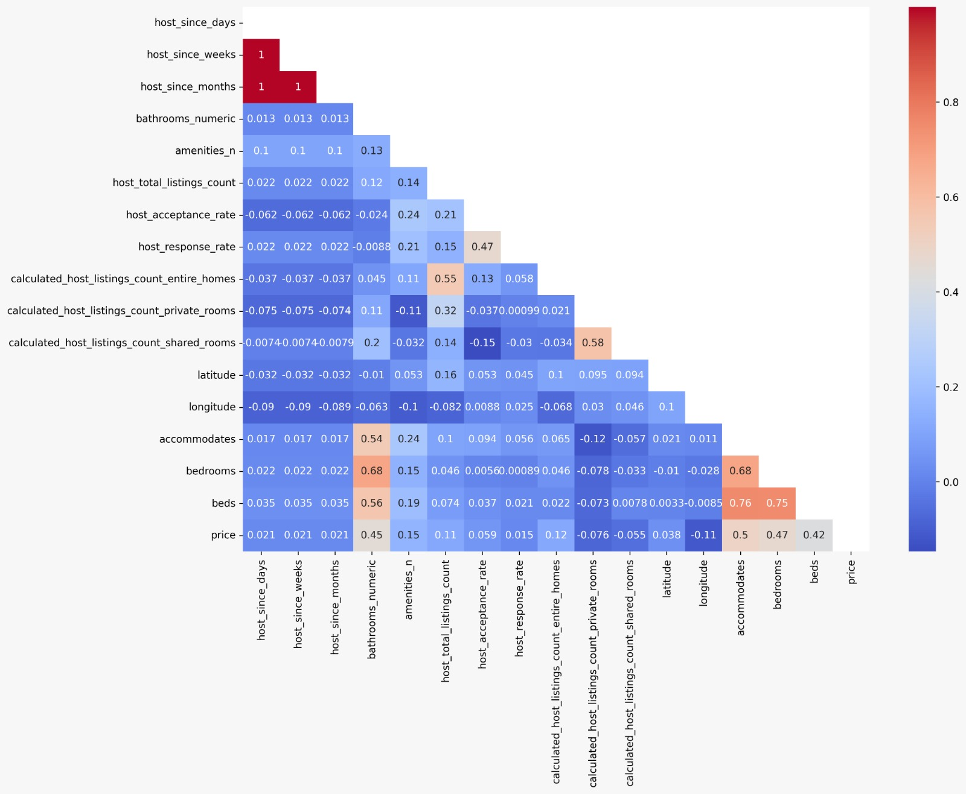
Correlaciones Correlación de Pearson – Variables Numéricas

Slide 23
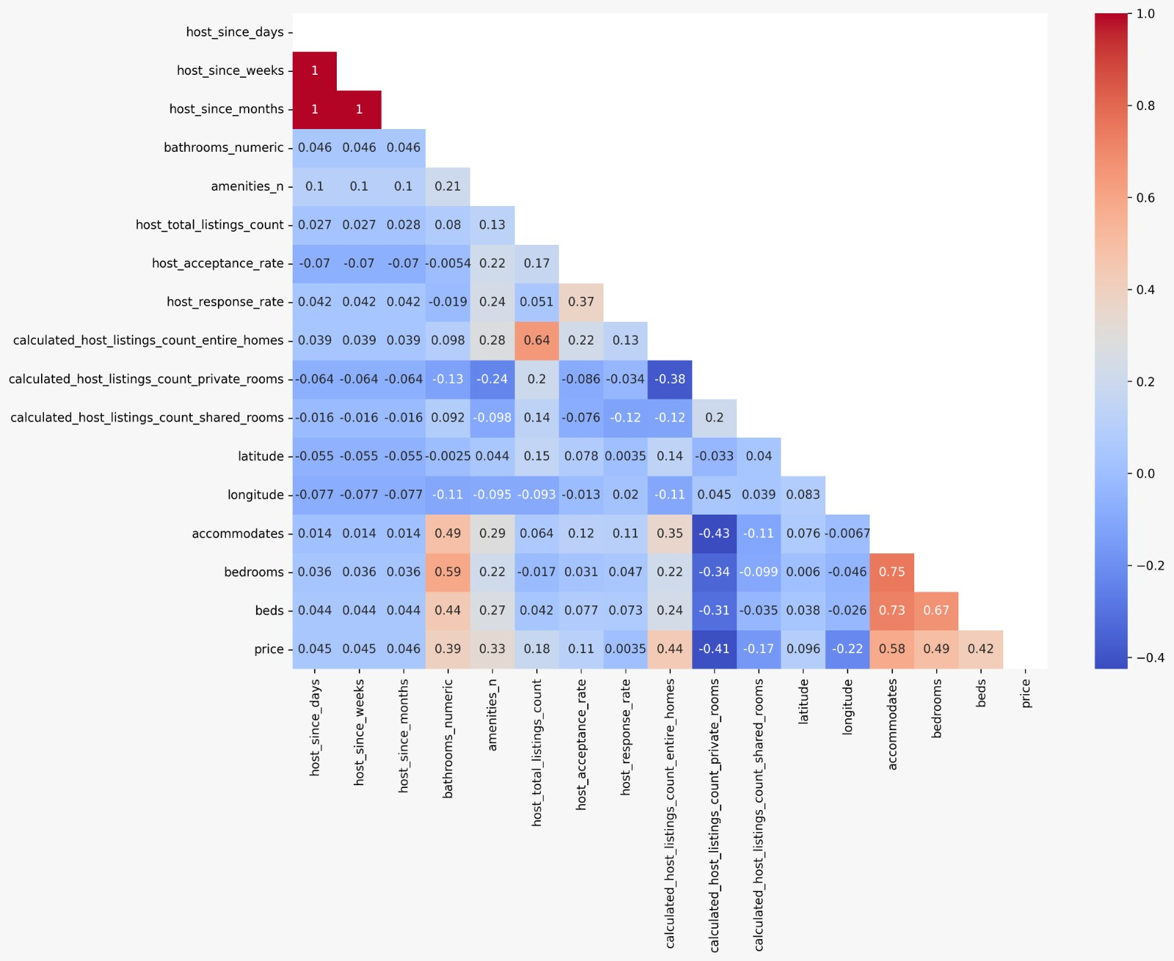
Correlaciones Correlación de Spearman – Variables Numéricas

Slide 24
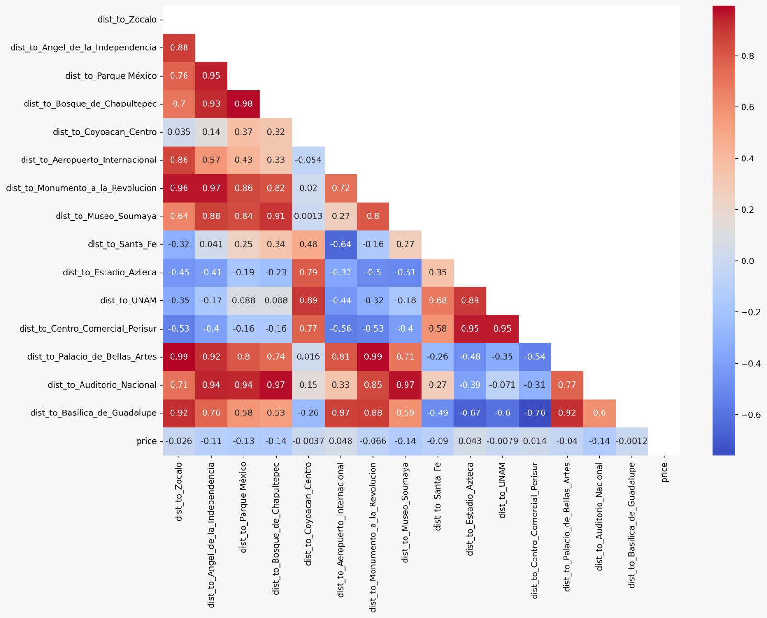
Correlaciones Correlación de Pearson – Distancias a puntos de interés

Slide 25
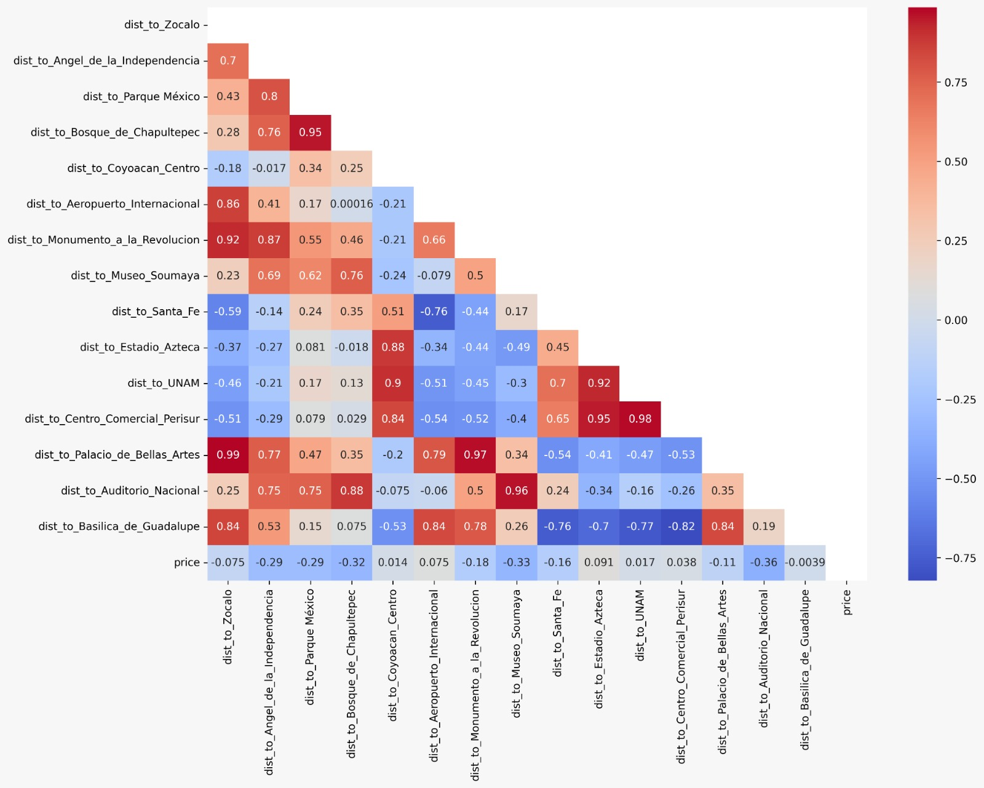
Correlaciones Correlación de Spearman – Distancias a puntos de interés

Slide 26
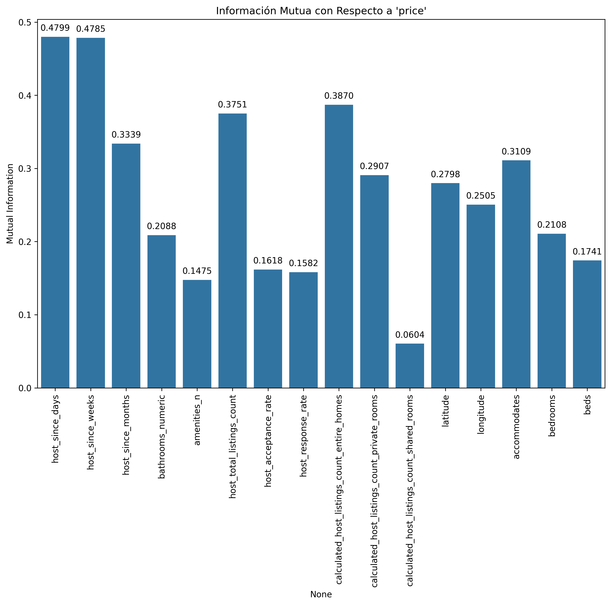
Información Mutua Variables Numéricas

Slide 27
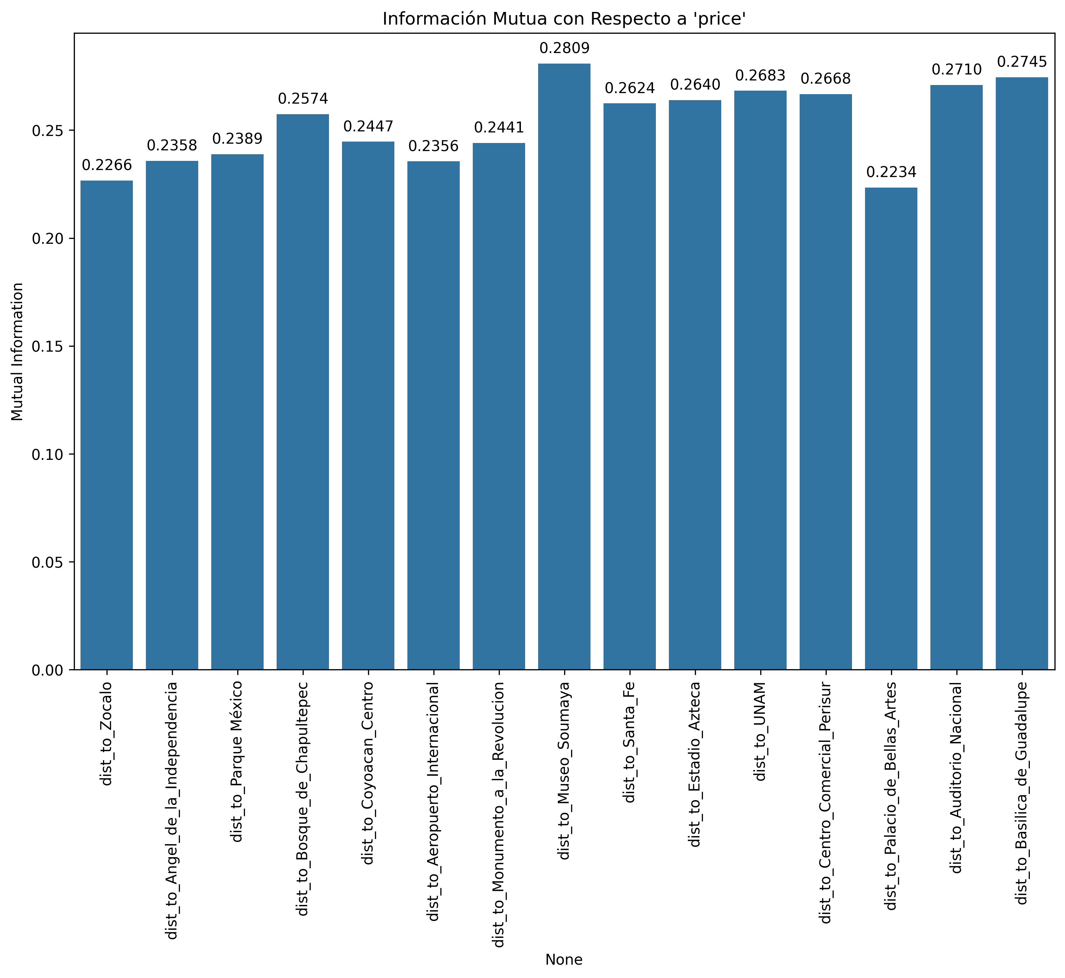
Información Mutua Distancias a Puntos de Interés

Slide 28
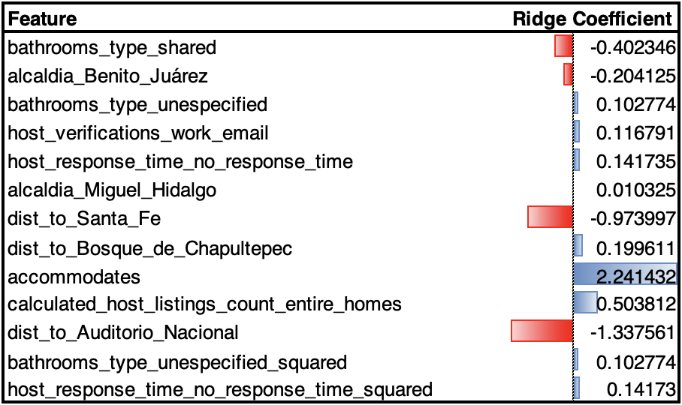
Baseline Modelo base utilizado
El modelo se ajusta con un escalamiento max-min.
Se hace un train-validation-test split (se hace fit de transformación sobre el train set y se aplican escalas y parámetros a validation y test): 70% train, 15% validation y 15% test.
El enfoque seleccionado fue una regresión lineal con regularización Ridge y Lasso:
Regularizada con Ridge: con la intención de gestionar el sobreajuste. También ayuda con la multicolinealidad ya que se decidió no hacer una eliminación dura por correlación.
Regularizada con Lasso: para la selección de variables se ha optado por utilizar Lasso.
Metric | Training (70%) | Validation(15%) | Test(15%)
RMSE | 0.5269 | 0.5317 | 0.5239
R² | 0.5001 | 0.504 | 0.4984
Es importante notar que a pesar de que el modelo no tiene el mejor desempeño, no presenta problemas relacionados con el sobre ajuste. La dirección y magnitud de los coeficientes de forma general tienen sentido.

Slide 29
Baseline Siguientes pasos
Análisis de los errores del modelo baseline, para evaluar si hay subgrupos o segmentos con concentración de error. Iterar el proceso de ingeniería y selección de variables considerando estos resultados.
Se invertirá más tiempo en el tunning de los parámetros de los modelos a utilizar para este modelo solo se usó un grid de 4 valores para los coeficientes de penalización: {0.01,0.1,0.5,1.0}.
Se optará por otras metodologías que puedan capturar de mejor forma las relaciones no lineales de las características, así como, por otras metodologías para la selección de variables.
Utilizar el Mean Absolute Percentage Error (MAPE) para entender el error en términos porcentuales, lo cual puede ser más interpretativo para decisiones de nuestro problema.
Utilizar validación cruzada para evaluar que no tengamos dependencia del split definido actualmente.

Slide 30
Intuiciones y Conclusiones
¿Los datos son pertinentes al problema?
La variable objetivo es el precio de un inmueble, determinado por factores como el número de recámaras, baños, camas y su ubicación. Aunque se eliminaron varias columnas, las más descriptivas fueron aquellas relacionadas directamente con las características del Airbnb.
¿Los datos están completos?
En los datos nulos se observa lo siguiente:
Solo 3 variables carecen completamente de información.
Solo 4 variables tienen más del 20% de valores nulos.
La variable objetivo (precio) presenta un 13.5% de valores nulos y se decidió eliminarlos.
Por lo tanto, la base de datos presenta porcentajes de valores nulos relativamente bajos, lo cual es suficiente para alimentar nuestro modelo.
¿Qué otros datos podrían recolectarse?
Faltan datos históricos relacionados con la estacionalidad de la demanda y ocupación del inmueble. No obstante, trabajaremos utilizando solo un año de información.

